Slide 1
Global Maternal Newborn Health Conference
October 2015
Mutsumi Metzler
PATH
Establishing Quality Product Supply of Chlorhexidine for Umbilical Cord Care through Local Production

Slide 2
Major supply-side strategies
Working with a global manufacturer.
Working with local/regional manufacturers and establishing regional production hubs in selected countries.

Slide 3
Working with local/regional manufacturers
Increasing production capability and capacity in
low- and middle-income countries (LMICs).
Existence of manufacturers with regional distribution network.
Opportunities for further local capacity development.
Product characteristics suitable for local production.
Tailoring to local needs (e.g., packaging).

Slide 4
Ensuring product quality is a multi-layered and multi-disciplinary effort
Regulatory authority
Acquisition of raw materials from quality sources
Pre-purchase/sale inspections
Production of the finished product in compliance with GMP
Proper use
Product release after proper QC
Registration according to in-country regulations
Manufacturers
Procurers and providers

Slide 5
Chlorhexidine Working Group approach
Select and work with qualified and committed manufacturers in countries where local production is feasible.
Develop standard information and materials for use by manufacturers, regulators, and procurers.

Slide 6
Three major steps to establish supply of quality product in LMICs
Assess the optimal way to establish product supply.
Select qualified and committed manufacturers in countries where local production is feasible.
Assist selected manufacturers to produce and register a quality chlorhexidine product.

Slide 7
Assessing the optimal way to establish product supply
Assess the optimal way to establish product supply.
Select qualified manufacturers in countries where local production is feasible.
Assist selected manufacturers to produce and register a quality chlorhexidine product.
Capability and capacity of pharmaceutical companies
  Strength of pharmaceutical industry.
  Experience in producing gels and/or solutions or chlorhexidine-based products.
Affordability
  Domestic market size.
  Duties on imported API and other raw materials.
Sustainability
  Domestic market size.
  Possibility of exporting.

Slide 8
Selecting qualified and committed manufacturers
Assess the optimal way to establish product supply.
Select qualified and committed manufacturers in countries where local production is feasible.
Assist selected manufacturers to produce and register a quality chlorhexidine product.
Issue an expression of interest (EOI).
Send a questionnaire to manufacturers who respond to the EOI to select a short list of manufacturers.
Perform on-site manufacturing facility assessment and business due diligence to select manufacturers that qualify for further technical assistance.

Slide 9
Assisting manufactures until product registration
Assess the optimal way to establish product supply.
Select qualified and committed manufacturers in countries where local production is feasible.
Assist selected manufacturers to produce and register a quality chlorhexidine product.
Perform in-depth GMP assessment and create corrective and preventive action (CAPA) plans.
Follow up with manufacturers to ensure that CAPA plans are properly implemented.
Assist with product development if required.
Assist creation and submission of regulatory dossiers if required.

Slide 10







2015 status
Lomus Pharmaceuticals Kathmandu, Nepal 2010
GlaxoSmithKline Brentford, England Evaluating TA and gap
supply support
ACI Limited
Dhaka, Bangladesh
2015
Assessment underway
2014/2015
Galentic Pharmaceuticals Mumbai, India Available through UNICEF Supply
Drugfield Pharmaceuticals Songo‐Atta, Nigeria 2014
Universal Corporation
Regulatory approval pending
2015
Countries which have local production
Countries which decided to import the product
PATH and the Promoting the Quality of Medicines (PQM) program implemented by the US Pharmacopeial Convention (USP) are working to establish local and regional manufacturing hubs for chlorhexidine in Asia and Africa

Slide 11
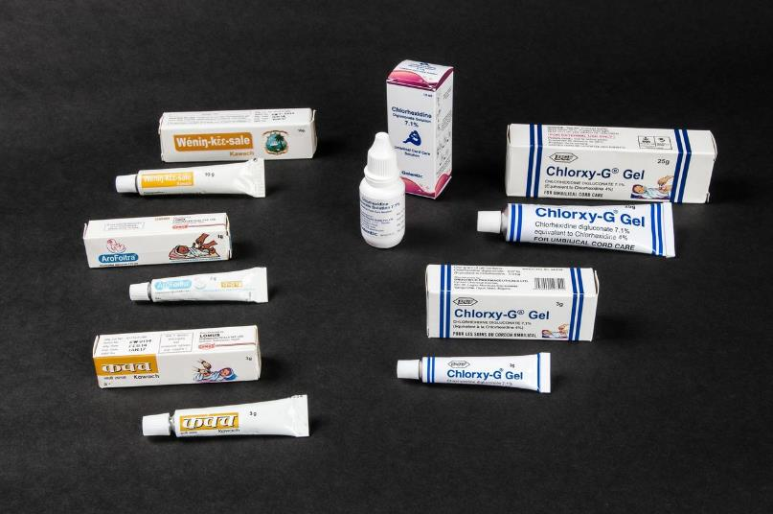
Commercial availability of 7.1% chlorhexidine digluconate
Solution
  UNICEF Supply Division catalogue
  ACI Limited (Bangladesh)
Gel
  Drugfield Pharmaceuticals Ltd. (Nigeria)
  Lomus Pharmaceuticals Pvt. Ltd. (Nepal)
Notes:
Currently, liquid and gel forms of 7.1% chlorhexidine digluconate are available from these sources.

Slide 12
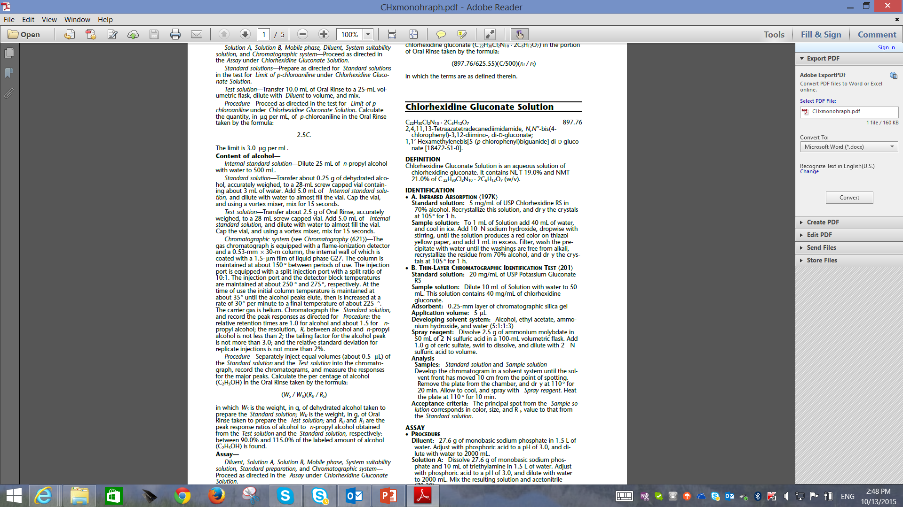
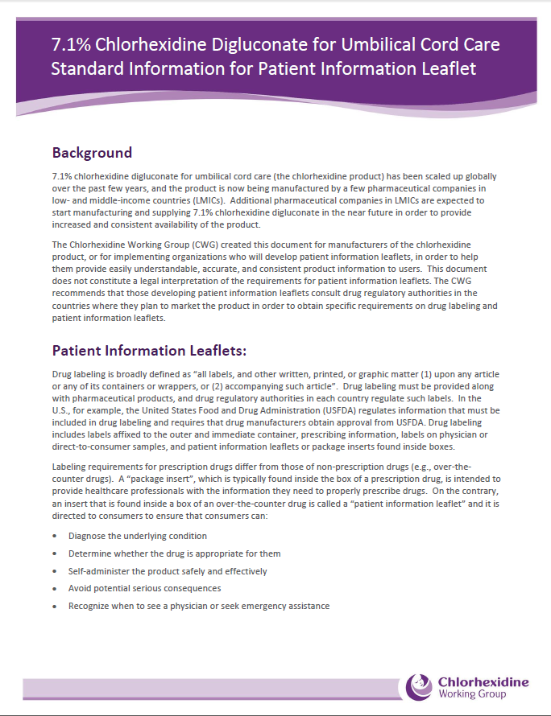
Documents created for manufacturers, procurers, and regulators
Monographs
  Monograph for chlorhexidine gluconate topical solution included in USP-NF.
  Monograph for chlorhexidine gluconate topical gel currently available for public comment in PF on USP website.
Standardized patient information leaflet.
Key consideration for procurers.

Slide 13

CWG technical assistance page http://www.healthynewbornnetwork.org/page/chlorhexidine-umbilical-cord-care-hub

Slide 14
Thank you!
Mutsumi Metzler, PATH
Patricia Coffey, PATH
Lawrence Evans, USP/PQM
http://www.healthynewbornnetwork.org/page/chlorhexidine-umbilical-cord-care-hub

