Slide 1
xx on behalf of the Core team
Place, date
Full set

Slide 2
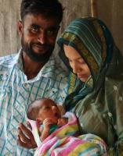
Outline
1
Why are 3 million newborns dying? Can we change?
Where do we want to be in 2035?
[Target setting and other analyses discussion]
How can we change outcomes for Every Newborn in every country? [Priority actions discussion]
What is the Every Newborn Action Plan?
What is the process for building a Movement and a Plan?
Who needs to be involved? [Discussion]
2
3
4
5

Slide 3
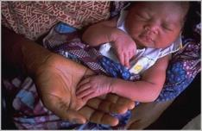
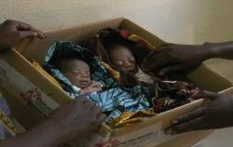
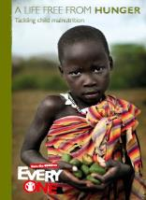
No newborn is born to die
Our delivery goal
No
baby
stillborn
No
child
stunted
or dying
~ 280,000 die
3 million die
2.6 million die
2.9 million die
10 million deaths
3.5 million within a few days of birth

Slide 4
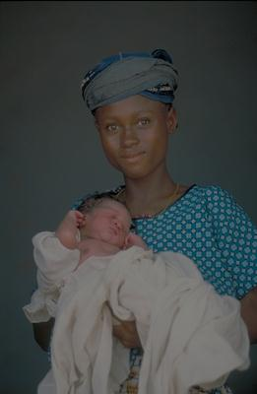
Global progress for reducing maternal, newborn and child deaths has accelerated with the MDGs
 | Average rate reduction 1990-2010
Maternal mortality ratio | 4.2%
Children aged 1- 59 months | 2.5%
Neonatal mortality (newborn, first 4 weeks after birth) | 1.8%
Stillbirths (last 3 months of pregnancy) | 1.0% (1995-2009)
At least 30% slower for newborn survival
But there are 3 data-based reasons why change is possible now
Source: Lawn J,E. et al. 2012. Newborn survival: a multi-country analysis of a decade of change. Health Policy and Planning. 27(Suppl. 3): iii6-ii28. Data sources: UNICEF 2011 www.childinfo.org , UN MMR estimates 2012

Slide 5
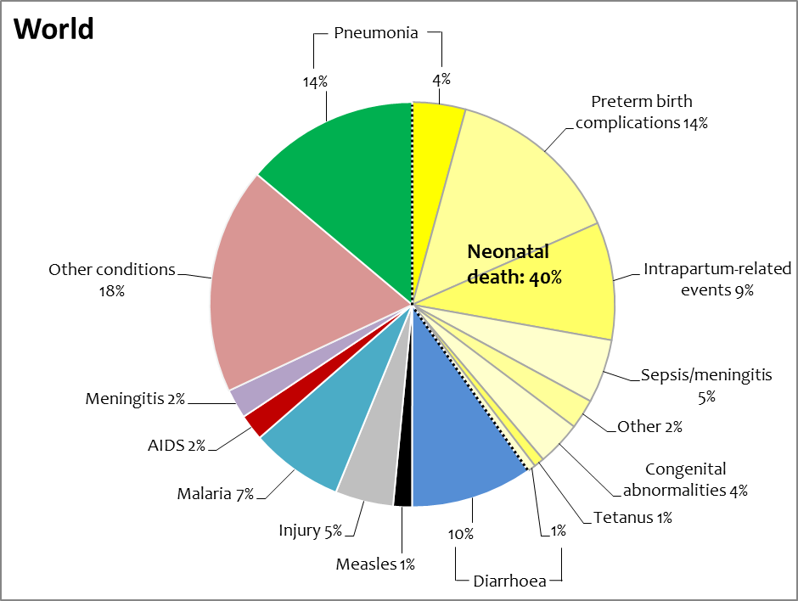
We know the causes of newborn deaths
CHANGE 1
3 main killers of newborns are known & addressable :
Preterm birth (born too soon)
Birth complications
Neonatal infections
3 million
43%
Newborn deaths invisible in global estimates until 2005 – now visible
Source :CHERG and WHO, Liu et al. 2012. Global, regional and national causes of child mortality in 2000-2010:.The Lancet. DOI:10.1016/SO140-60560-1.
In 2010 40% of under five deaths were neonatal. In 2011 it as 43%
5

Slide 6
We can reduce the main causes of death
Newborn Survival Solutions – 3 by 2
CHANGE 2
Preterm birth
Preterm labor management including antenatal corticosteroids*
Care including Kangaroo mother care, essential newborn care
Birth complications (and intrapartum stillbirths)
Prevention with obstetric care *
Essential newborn care, and resuscitation*
Neonatal infections
Prevention, essential newborn care especially breastfeeding, Chlorhexidine where appropriate*
Case management of neonatal sepsis *
1
2
3
* Prioritised by the UN Commission on Life Saving Commodities for Women and Children
Over two-thirds of newborn deaths preventable – actionable now without intensive care

Slide 7
We have proof of change at scale
Some countries are “bending the curve”
for newborn survival despite low income
CHANGE 3
Over the last decade
77 countries reduced NMR by >25%
including at least 13 low income countries
Bangladesh, Bolivia, Eritrea, Guatemala, Indonesia, Nepal, Madagascar, Malawi, Morocco, Senegal, Rwanda, Tanzania, Vietnam
 | MDG 4 | MDG 5 | Neonatal mortality rate Av annual change 2000-2010
Rwanda |  | Progressing | 6.2%
Bangladesh |  |  | 4.0%
Nepal |  |  | 3.6%
Malawi |  | Progressing | 3.5%
Source: Newborn survival decade of change analysis: Health Policy and Planning. 27(Suppl. 3) papers 3 to 7

Slide 8
Outline
1
Why are 3 million newborns dying? Can we change?
Where do we want to be in 2035?
[Target setting and other analyses discussion]
How can we change outcomes for Every Newborn in every country? [Priority actions discussion]
What is the Every Newborn Action Plan?
What is the process for building a Movement and a Plan?
Who needs to be involved? [Discussion]
2
3
4
5

Slide 9
Absolute target by 2035 for A Promise Renewed Under 5 mortality = 20/1000
Mortality rate (per 1,000 live births)
U5M current trajectory: ARR 2.5%
MDG 4 achieved in 2035
4 million deaths annually in 2035
U5M ARR 5.2%
2 million deaths by 2035
Every country reaches 20/1000 Many countries below 15/1000
9.6 mm deaths in 2000
6 m deaths in 2011
MDG 4
NMR current trajectory of ARR 2.2%
Unless we achieve major acceleration for newborn survival, we cannot reach our goal for ending preventable child deaths by 2035
Source: UNICEF State of the World’s Children 2012; The UN Inter-agency Group for Child Mortality Estimation, Levels and Trends in Child Mortality: Report 2011, 2011; Team analysis from 2035 onward based on straight-line ARR reduction from UNICEF numbers 1990-2035

Slide 10
When will every newborn have the same survival chance as the richest (absolute target of NMR=3)?
Years needed for each region to reach current industrialized region NMR (=3) based on regional average rate of reduction (ARR) from 2000-2011
East Asia/Pacific
Year: 2038
140 YEARS FOR AFRICAN NEWBORNS…
Three times longer than the same change took rich countries a century before, despite new interventions
Latin America/Caribbean
Year: 2039
CEE/CIS
Year: 2039
Middle East/North Africa
Year: 2082
Sub-Saharan Africa
Year: 2155
South Asia
Year: 2125
10

Slide 11
Reducing preventable neonatal deaths by 2035
Worldwide target options considering absolute targets of NMR=5 or NMR=10
Current trajectory
NMR in 2035: 13
ARR: 2.2%
NMR target of 10 by 2035
ARR: 3.2%
NMR target of 5 by 2035
ARR: 6.0%

Slide 12
Absolute targets mean the ambition differs by region
Considering regional variation to reach absolute target of NMR = 5
For 3 regions almost done already
Africa to increase >4 fold
South Asia to increase >3 fold
which is ambitious
South Asia
Sub-Saharan
Africa
Middle East/North Africa
East Asia/Pacific
CEE/CIS
Latin America/
Caribbean

Slide 13
Relative targets set the same pace for every country
Considering a relative target of reducing NMR by 75% from 2011
All regions have to achieve the same ARR (5.7% for all), but then still left with a gap in outcomes for the poorest
South Asia
Sub-Saharan
Africa
Middle East/North Africa
East Asia/Pacific
CEE/CIS
Latin America/
Caribbean

Slide 14
Analyses planned
Target setting (multiple scenarios for 2035 examined but not all included in this short consultation session, also working on interim targets and welcome ideas on this)
Mortality
Trend analyses (U5MR and NMR and SBR) at global, regional, national level
Best performers and what would happen if other countries matched that rate of reduction of NMR and also more understanding of why
Equity analysis for mortality and coverage
Contribution of preterm birth and small for gestational age (Lancet nutrition series link)
Morbidity and impairment, which are linked quality of MNH care (drawing on CHERG/GBD work in process and due publication in Nov 2013)
Lives saved and cost analyses
How many lives could be saved with existing interventions, by cause of neonatal mortality and showing impact of same interventions on stillbirths and maternal deaths
Context specific (eg NMR level)
Costs required to reach global targets and costs per life saved
Bottleneck analyses in about 15 high burden countries

Slide 15
Target setting discussions
Universal?
Consensus so far on universal , change for all of the next generation
Absolute vs. relative target and level of target?
No consensus but tendency towards absolute (number) versus relative (%).
Possible option is absolute target of 7.5/1000 as ~highest current NMR in OECD countries
Other points arising from discussions so far
Stillbirths count - should have an outcome level target (note Lancet Stillbirth Series Goals for 2020)
Timeframe 2035 is far away - need interim targets and can explicitly map with other initiatives eg FP 2020, A Promise Renewed
Equity - principle of equity rather than safety in averages, eg subnational targets
Define “preventable mortality” and note may be context specific and for a given country may change over time
Your discussions and feedback are welcome and will inform target setting
Notes:
Strong tendency

Slide 16
Outline
1
Why are 3 million newborns dying? Can we change?
Where do we want to be in 2035?
[Target setting and other analyses discussion]
How can we change outcomes for Every Newborn in every country? [Priority actions discussion]
What is the Every Newborn Action Plan?
What is the process for building a Movement and a Plan?
Who needs to be involved? [Discussion]
2
3
4
5

Slide 17
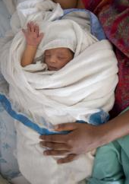
Priority actions
WHEN? Focus on care during labour, birth and day after birth - the time to save lives of women, newborns, & prevent stillbirths.
WHAT? High coverage of high impact interventions for women and babies, addressing context specific and intervention specific bottlenecks.
HOW? Quality of care matters as much as coverage and requires investment, especially for effective care at birth. Skilled workers are the key to change.
WHO? Reaching every girl, every women, every newborn including the poorest, universal coverage and equity achieved.
PEOPLE POWER? Families and communities mobilising change.
COUNTING? Measurement, oversight and accountability, improve and use the data.
Notes:
The Core Group of stakeholders who decided and started the process of developing the GNAP identified a set of themes or strategic directions that the GNAP may recommend; these, as everything else, will be discussed with countries and other stakeholders.
Prioritizing action during labour, childbirth and the first days of life
One-third of stillbirths and 75% of newborn deaths occur within this period. Many complications can be prevented by ensuring high quality, essential care for every pregnant woman and every newborn around the time of childbirth and in the first hours and days of life.
Scaling up effective interventions to tackle the main causes of mortality
Prematurity/low birth weight, birth asphyxia and neonatal infections are the leading causes of newborn mortality. Using the platform of essential care for every pregnant women and baby, these causes can be identified and tackled with affordable interventions at scale.
Quality of care matters as much as coverage of care
Skilled birth attendants are essential in providing care for both the woman and her baby. However, quality of care is often poor. Investments to ensure that care meets required standards is essential for supporting both normal and complicated births.
Towards universal coverage and equity
Skilled care at childbirth is one of the most inequitable interventions, affecting vulnerable and deprived populations, in both urban and rural settings. Closing the equity gap within countries alone can save many maternal and newborn lives.
Empowering women, families and communities
Education and information is key to empowering women, families and their communities to demand quality care. Evidence has shown the power of engaged community leaders, women’s groups, and community workers in turning the tide for better health outcomes.
Measurement, oversight and accountability
The action plan will be underpinned by a set of indicators and targets related to reach of the key themes. By measuring what we do, we can stimulate progress, make adjustments along the course, and account for commitments
Action by all
The plan will seek to unleash the power of all who can make a difference in ensuring that every pregnancy is wanted and safe and that every newborn care make a healthy start in life.

Slide 18
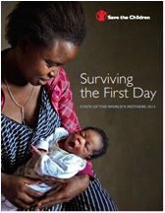
Action 1 – WHEN? Prioritize care during labour, birth and in the first days of life
ACTION 1
The critical window of risk and of opportunity
Most direct obstetric maternal deaths
Around half of stillbirths (1.2 million)
Around half of newborn deaths, 1 million babies dying on their birth day

Slide 19
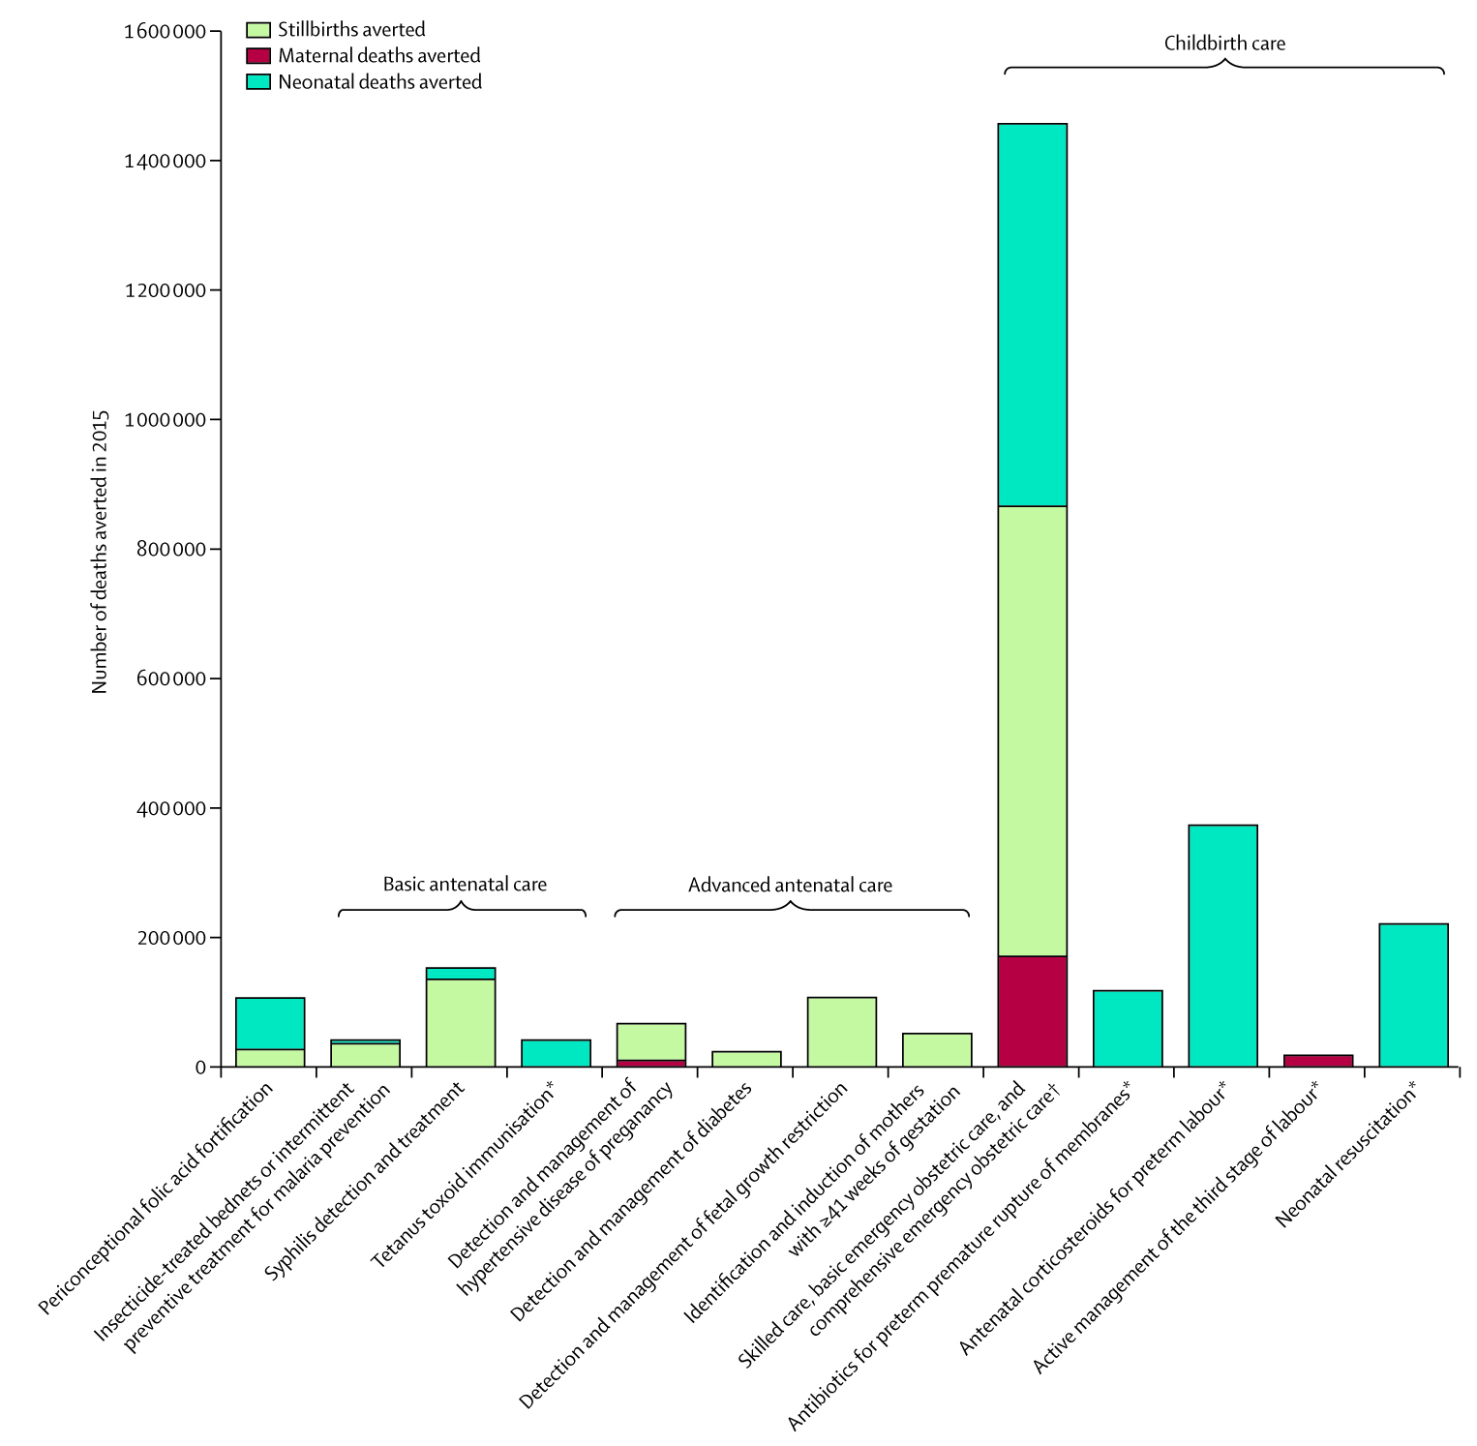
Care at birth, analysis from The Lancet Stillbirth series
ACTION 1
Childbirth care
Basic
antenatal
Advanced
antenatal
Deaths prevented: Stillbirths 1.1 million (45%)
Newborn deaths 1.4 million (43%)
Maternal deaths 201,000 (54%)
TRIPLE RETURN ON INVESTMENT
Source: Pattinson R, Kerber K, Buchmann E, et al, for The Lancet’s Stillbirths Series steering committee. Stillbirths: how can health systems deliver for mothers and babies? Lancet 2011; published online April 14. DOI:10.1016/S0140-6736(10)62306-9.

Slide 20
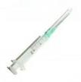
Commodities with high impact around birth
ACTION 1
 | Estimated annual newborn lives saved at universal coverage
Case management of neonatal sepsis * | ~ 500,000
Chlorhexidine umbilical cord cleaning * | (cannot yet estimate in LiST)
Antenatal corticosteroids for preterm labour* | ~ 430,000
Neonatal resuscitation* Kangaroo Mother care | ~ 230,000 ~450,000
* Prioritised by the UN Commission on Life Saving Commodities for Women and Children
Sources: Born Too Soon Chap 5 2012, Lawn J et al, IJGO, 2009

Slide 21
Action 2 – WHAT? Scale up high impact essential care for every women, every newborn, addressing context specific bottlenecks
ACTION 2
For example kangaroo mother care is highly cost effective in reducing newborn deaths and disability and also reducing the load on the health system.
BUT it is being scaled up more rapidly in high income than low income countries – why?? The reasons differ and we need to understand them to accelerate progress

Slide 22
ACTION 2
Newborn care fits in health system packages of care and focus on birth gives extra impact
REPRODUCTIVE HEALTH CARE
OBSTETRIC AND CHILDBIRTH CARE including essential newborn care
EMERGENCY NEWBORN CARE
EMERGENCY CHILD CARE
Clinical
REPRODUCTIVE HEALTH CARE
ANTENATAL CARE
POSTNATAL CARE
CHILD HEALTH CARE
Outreach/outpatient
ADOLESCENT HEALTH AT HOME AND SCHOOL
PREGNANCY HOME VISITS
CLEANER, SAFER BIRTH
EARLY POSTNATAL HOME VISITS FOR MOTHER AND NEWBORN
ONGOING CARE FOR THE CHILD AT HOME
Family/community
INTERSECTORAL Improved living and working conditions including housing, water and sanitation, and nutrition
Education and empowerment
Pre-pregnancy
Pregnancy
Birth
Newborn/postnatal
Childhood
Source: Adapted from Kereber et al Lancet 2007
Notes:
22

Slide 23
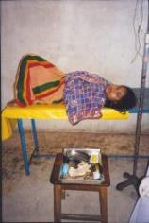
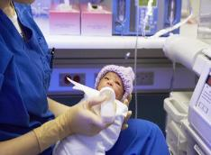
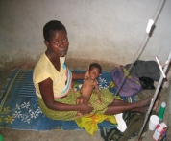
Action 3 – HOW? Quality of care matters as much as coverage
ACTION 3
The quality gap is a contributor to slow progress towards MDG 4 and 5 and leads to significant morbidity as well as mortality.
Increased coverage of facility care at birth is an opportunity to ensure that all women and babies receive effective, safe respectful care
Programmatic change is possible and will also require better data to drive change.

Slide 24
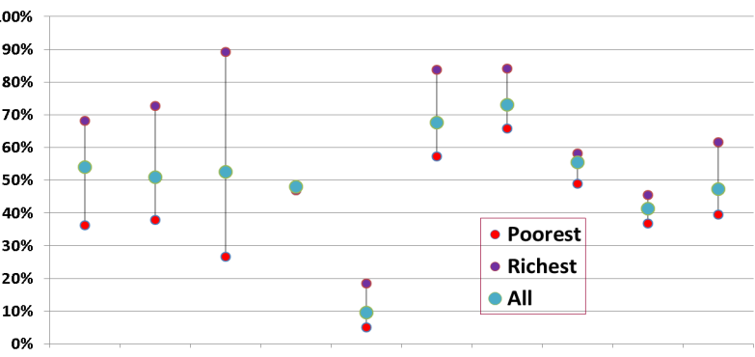
Action 4 – WHO? Towards universal coverage and equity
ACTION 4
Greatest inequity is for care around time of birth
Coverage
Demand for FP satisfied
Antenatal care (4+ visits)
Skilled attendant at birth
Early initiation of breastfeeding
Children sleeping under ITNs
DTP3 immunization
Measles immunization
Vitamin A supplementation
Oral Rehydration Therapy
Careseeking for pneumonia
Source: Barros AJD et al., Equity in maternal, newborn and child health interventions in Countdown to 2015: from 54 countries. Lancet 2012; 379: 122533.

Slide 25
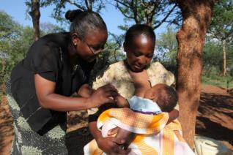
Action 5 – PEOPLE POWER Empowering women, families and communities
ACTION 5
Engaging community leaders and empowering women's groups
Fostering the power of parent action groups around the world
Equipping community health workers for essential care

Slide 26
Priority action discussions
WHEN? Focus on birth
WHAT? High coverage of high impact interventions
HOW? Quality of care matters
WHO? Reaching every women, every newborn including the poorest,
PEOPLE POWER? Families and communities mobilising change.
COUNTING? Measurement, oversight and accountability
Are there important actions to include which have been missed?
How to better reflect the realities of private sector?
Your discussions and feedback are welcome!
Notes:
Strong tendency

Slide 27
Outline
1
Why are 3 million newborns dying? Can we change?
Where do we want to be in 2035?
[Target setting and other analyses discussion]
How can we change outcomes for Every Newborn in every country? [Priority actions discussion]
What is the Every Newborn Action Plan?
What is the process for building a Movement and a Plan?
Who needs to be involved? [Discussion]
2
3
4
5

Slide 28
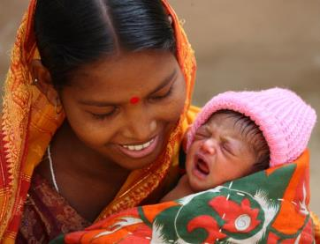
Why Every Newborn?
Country demand for guidance and action, country driven
Large problem but huge potential for rapid change since we know what to do and can develop clear context specific guidance on HOW
Harmonize global response which so far has been slow and needs to link to many existing initiatives for reproductive, maternal, child and adolescent health care, scaling up global attention and action
Notes:
First, why do we need this sort of concise roadmap for change?
There are three main reasons:
First, countries are asking for guidance on scaling up key interventions and strategies to reduce these deaths and to prevent stillbirths.
Second, we have the evidence on what works. Last year, PMNCH issued its consensus on essential interventions for RMNCH – those commodities and services proven to save lives of women and children. This year, we have heard from the UN Commission on Life-Saving Commodities for Women and Children, which highlight the importance of greater advocacy and action on corticosteroids, chlorohexidrine, injectible antibiotics and recussitation equipment to prevent newborn deaths. We need to work together, across all constituencies, to deliver these solutions at scale and drive greater public demand for essential newborn care.
Third, we need to drive global action and greater harmonization between maternal and child health initiatives and strategies. Newborns, bringing together maternal and child health concerns, can help unite our work and root it more firmly in the continuum of care.

Slide 29
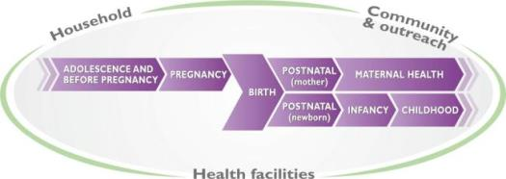
What is the Every Newborn Action Plan?
A roadmap for change
A platform for harmonised action by all partners
Setting out a clear vision with mortality target, strategic directions, and innovative actions within the continuum of care
Supported by evidence on epidemiology, effective interventions, delivery mechanisms and accelerators to progress to be published in The Lancet at the time of the launch in May 2014
Notes:
The Global Newborn Action Plan will provide the international community with a roadmap and joint action platform for the reduction of preventable newborn mortality. Linking the work of all stakeholders, the Action Plan will enable policy makers and all stakeholders to take action to accelerate national plans to achieve clear results for newborn healthy survival and reducing stillbirths. This is not a long document: Like the Global Strategy, we envisage this will be about 24 pages of high-level guidance aimed at policy makers.
The Plan will set out a vision, targets and objectives, and will recommend key actions to implement based on proven strategies for change and the latest evidence on interventions effectiveness, costs and expected impact. It will define the role and responsibilities of stakeholders.
The GNPA will be supported by new analyses that include:
NMR reduction projections to define NMR and ARR targets by 2035
Updated trends in NMR and causes of death
Coverage trends for main interventions (e.g. SA at birth)
Update on evidence of effectiveness of interventions to address stillbirths and newborn deaths
Review of strategies to accelerate scale up of interventions
Estimated lives saved and cost of scaling up intervention packages
The GNAP calls upon all stakeholders who can make a difference for newborn health. Foremost, it aims to support government leadership and the actions of policy makers and program managers. It encourages the sharpening of existing health sector plans and linkages with other global and national strategies.
Key actors include health professional associations, parliamentarians, the media, academic institutions, multi-lateral and bilateral agencies, foundations, the private sector and civil society, including women’s and parent’s organizations. We all have a role to play.

Slide 30
Newborn action supports the Global Strategy
Country leadership & Implementation
Key catalytic initiatives in support of Every Woman Every Child
Family Planning Summit
Every Newborn
A Promise Renewed
Global action plans: scaling up nutrition,
global action plan for pneumonia & diarrhea, Born Too Soon, WASH for all
Commission on Live-saving Commodities
Who? Global mechanisms for coordinated action and advocacy
Some examples:
Commission of Information and Accountability Recommendations
Independent Expert Review Group
10-part framework for global reporting, oversight and accountability on women's and children's health
Reviewing progress on the Global Strategy and
the Commission’s recommendations
www.everywomaneverychild.org

Slide 31
How it fits together at Country Level
National Health Sector Plans
RMNCH Strategic Plan
Increased access and use of FP
Ending preventable maternal deaths
Ending preventable newborn deaths
Ending preventable child deaths
COMMODITIES, HUMAN RESOURCES etc.

Slide 32
Who is involved to build this movement?
Global plan for country action linked to Every Woman Every Child, and to A Promise Renewed, following Born Too Soon report and World Prematurity Day movement
Global partnership with multiple organizations including:
Country governments and parliementarians
United Nations
NGOs
Universities and Professional organizations
Donors and foundations
All the PMNCH 500+ constituencies
Country consultations and global communities
Global launch May 2014 linked to the World Health Assembly
NATIONAL action by professionals, policymakers and parents = ALL OF US !!
32

Slide 33
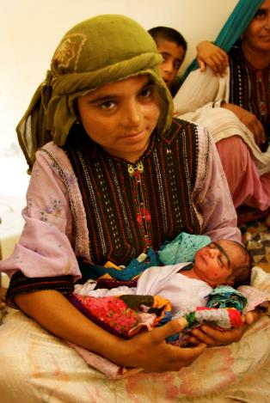
Every Newborn Country Consultation
Stimulate national dialogue and action to accelerate progress for newborn health and stillbirth reduction by all key country stakeholders
Systematically assess status for high impact interventions and plan how to overcome bottlenecks for scale-up and ensure reflected in government plans with adequate funding
Enable countries to feedback on the Every Newborn plan content, goals and actions so this is truly grounded in real change (country up, not a global down plan
Country and regional consultations from June – September 2013

Slide 34
Country Consultations – which countries and when?
20 “analysis” countries selected as follows:
2 fastest progressors for NMR reduction for 4 regions (8), will have country case study, several linked to Countdown to 2015 case studies
12 highest burden countries (2 of which are also fast progressors – Bangladesh and China), will have detailed bottleneck analysis for 8 high impact interventions/packages
Country/ Regional consultations in:
Uganda – this week!
West Africa (UNICEF Dakar office) 9th-12th July
Asia (Kathmandu UNICEF office) late August
India in progress
Other countries are moving ahead based on interest eg Zambia,
Every Newborn Toolkit provides supporting materials for planning

Slide 35
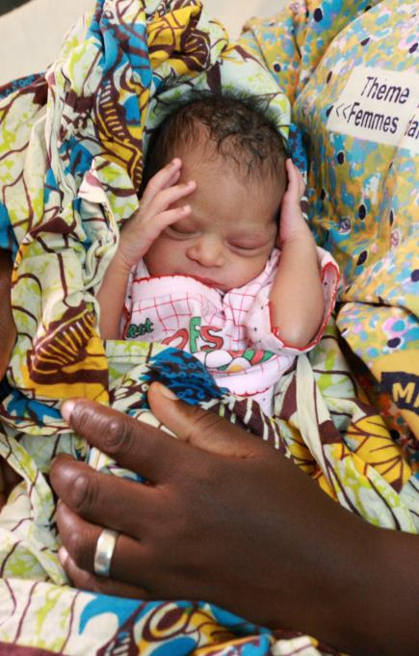
Every Newborn Toolkit
Overview of Every Newborn
Cover letter
Advocacy brief
Messages
Actions
Consultation process and events
Country consultation overview
Calendar
Tools for consultations
Maternal-newborn bottleneck tool
Overview of other tools
Other materials to support consultation process
Plan outline for consultation
PPTs
Country fact sheets
Library on newborn health
Notes:
This Toolkit provides practical support to all those engaged in promoting greater action and accountability on newborn and maternal health through national planning and programming, advocacy, research, implementation, and monitoring and evaluation. The Toolkit can be divided into 4 sections:
Overview of Every Newborn
Consultation process and events
Tools needed to conduct a country consultation
Other materials to support consultation process
INTRODUCTION
Every Newborn cover letter: This letter provides a summary of all of the components in the Toolkit.
Every Newborn brief: This two-page brief describes the background, audience, development plan and emerging themes for the Every Newborn action plan. It offers a useful introduction to the plan for potential partners who are considering participation in a national or global planning or advocacy.
Every Newborn messages: This section provides main messaging to harmonize advocacy among partners and in countries. It includes a section on frequently asked questions.
Every Newborn actions: Proposed actions necessary to address preventable newborn deaths by various stakeholders are presented in this section of the Toolkit.
CONSULTATIONS
Every Newborn consultation overview: This short brief summarizes the consultation plan and process providing an overview for designing and implementing national consultation meetings on Every Newborn, including sample agendas and suggestions on participation.
Every Newborn events calendar: This calendar presents key global, regional and country events and dates that will feature activity for developing and taking forward the Every Newborn plan.
TOOLS
Newborn Health Tools: Some key analytical tools relating to newborn health are provided to encourage use of evidence and data to inform the newborn component.
Every Newborn bottleneck analysis tool: This tool aims to support countries analyse health system bottlenecks and challenges preventing the scale up of high-impact, cost-effective interventions for newborns and identify solutions.
OTHER MATERIALS TO SUPPORT CONSULTATIONS
Every Newborn plan outline: The draft outline of Every Newborn: an action plan to end preventable newborn deaths proposes a vision, goal and targets as well as strategic directions with action areas. Everyone who is interested in Every Newborn is invited to review the proposed content, and make comments.
Every Newborn PowerPoint: This PowerPoint presentation gives an overview of the global newborn data, priority actions, and the way forward for developing the plan. The presentation can be used by partners to inform others about the process for developing Every Newborn and the goals it aims to achieve.
Country Fact Sheet: One page fact sheets are provided on newborn health data and trends for select countries. This can be created for other countries on a request bases.
Library on newborn health: This document details selected newborn-related global and regional strategies, publications, and resource. These resources can also be used to inform the newborn component of policies, strategies and guidelines as well as assist in the country consultation on the Every Newborn plan and the bottleneck analysis.

Slide 36
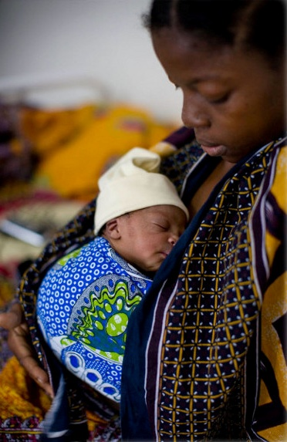
Every Newborn Timeline
May – September 2013
Global and regional events
National and regional consultations
October 2013 – May 2014
Present to the WHO Executive Board
Finalize Every Newborn including production and translations
May 2014
Launch linked to 67th World Health Assembly
Lancet series (update from 2005 and giving the analyses which are the basis for the Every Newborn)
Online: www.globalnewbornaction.org
#NewbornActionPlan
Send your inputs! Join the action!
Notes:
What are the next steps ?
We plan several consultations; some will take place at major global and regional conferences and meetings including the this Global Newborn Conference, Women Deliver, the World Health Assembly in May 2013, Pacific Health Summit, International Congress of Pediatricians, International Neonatal Nursing Conference, UN General Assembly, High-Level Meeting on the Post-MDG Framework
* National consultations will be organized in 20 countries during July-September, accompanied by a technical review of current plans, policies and investments to identify where evidence-based action can be scaled up. Regional consultations will be carried out at the same time, starting in the W African region in early July.
The GNAP development is a multi-stakeholder process. It is coordinated by a multi-stakeholder Core Group (led by WHO aned UNICEF with PMNCH, BMGF, USAID, LSHTM, Save the Children, the Global Alliance to Prevent Prematurity and Stillbirths, the Children’s Investment Fund Foundation, as well as country government representatives.)
An Expanded Reference group/Advisory Group is being formed to provide expert advice and reviews. This group will include country representatives, the private sector, civil society, representatives from other constituencies, as well as additional senior staff from the Core Group of partners.
Working groups include an analytical group, an advocacy group and an Implementation group that will start planning the post-launch period so that concrete action follows the Plan launch.
Finally, all can be involved online at globalnewbornaction.org
Launch will take place in May 2014 in association with the World Health Assembly in Geneva. At the same time, a new Lancet series on neonatal survival will be launched, linking with the analysis and consultations undertaken for this plan.

Slide 37
Implications and discussion
Customise slide to audience to get discussion on implications for that country, or specific audience and feedback on “Every Newborn”
Your discussions and feedback are welcome!
Notes:
Strong tendency

Slide 38
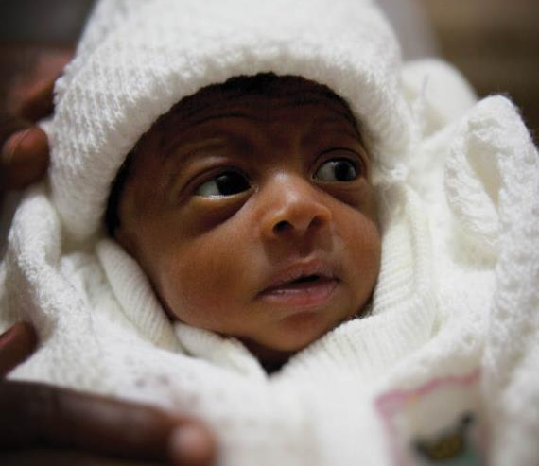
Be part of the action for newborns
#Newborn2013
#GlobalNewbornAction

