Slide 1
Every NewborN
Overview of the Series
“A healthy start is central to the human life course, with birth holding the highest risk of death, disability and loss of development potential, leading to major societal effects.”
Overview for Every Newborn collection May 2014.
Please check everynewborn.org for latest version.

Slide 2
Adapting this presentation
Personalise with local photos.
Consider adding country or regional-level data as comparison slides.
Use local examples of programmes and best practices.
The charts and graphs are based on best available data up to 2013.
Please credit The Lancet Every Newborn Series and link to the website

Slide 3
Every Newborn Series
5 papers
6 comments
55 authors from 18+ countries
60+ partner organizations
Main funders: Bill & Melinda Gates Foundation, USAID, Children’s Investment Fund Foundation
Every Newborn Action Plan
Based on the evidence from the Series
Co-led by UNICEF & WHO
World Health Assembly 2014 resolution
Launched 30th June 2014

Slide 4
Every Newborn Series Papers
Who has been caring for the baby?
Gary L Darmstadt, Mary V Kinney, Mickey Chopra, Simon Cousens, Lily Kak, Vinod K Paul, Jose Martines, Zulfiqar A Bhutta, Joy E Lawn, for The Lancet Every Newborn Study Group
Progress, priorities, and potential beyond survival
Joy E Lawn, Hannah Blencowe, Shefali Oza,, Danzhen You, Anne CC Lee, Peter Waiswa, Marek Lalli
Can available interventions end preventable deaths in mothers, newborn babies,
and stillbirths, and at what cost?
Zulfiqar A Bhutta, Jai K Das, Rajiv Bahl, Joy E Lawn, Rehana A Salam, Vinod K Paul, Jeeva M Sankar, Hannah Blencowe, Arjumand Rizvi, Victoria B Chou, Neff Walker, for The Lancet Newborn Interventions Review Group and The Lancet Every Newborn Study Group
Health-systems bottlenecks and strategies to accelerate scale-up in countries
Kim E Dickson, Aline Simen-Kapeu, Mary V Kinney, Luis Huicho, Linda Vesel, Eve Lackritz, Joseph de Graft Johnson, Severin von Xylander, Nuzhat Rafique, Mariame Sylla, Charles Mwansambo, Bernadette Daelmans, Joy E Lawn, for The Lancet Every Newborn Study Group
From evidence to action to deliver a healthy start for the next generation
Elizabeth Mason, Lori McDougall, Joy E Lawn, Anuradha Gupta, Mariam Claeson, Yogan Pillay, Carole Presern, Martina Baye Lukong, Gillian Mann, Marijke Wijnroks, Kishwar Azad, Katherine Taylor, Allison Beattie, Zulfiqar A Bhutta, Mickey Chopra, for The Lancet Every Newborn Study Group, on behalf of the Every Newborn Steering Committee

Slide 5
Series key findings
Within reach: ending of preventable child and maternal deaths
Prioritize day of birth
Invest in care at birth and reap a triple return
Target specific health system bottlenecks
Unprecedented opportunity for progress is now
Count every mother and every newborn baby

Slide 6
Within reach: ENDING PREVENTABLE CHILD AND MATERNAL DEATHS
Every Newborn Series key actions

Slide 7
When will every newborn have the same survival chance as newborns in the richest countries?
Years for each region to reach NMR of 3 = industrialized countries current average
By projecting regional average rate of reduction 2000-2011
North Africa/West Asia
Year: 2051
Latin America/Caribbean
Year: 2043
Eastern Asia
Year: 2028
Caucasus/Central Asia
Year: 2062
Sub-Saharan Africa
Year: 2124
South-East Asia
Year: 2070
Southern Asia
Year: 2103
NMR 3
NMR 1
110 YEARS FOR AFRICAN NEWBORNS…
Nearly 3 times longer than this change took rich countries, despite new interventions
Source: Lancet Every Newborn series, paper 2

Slide 8
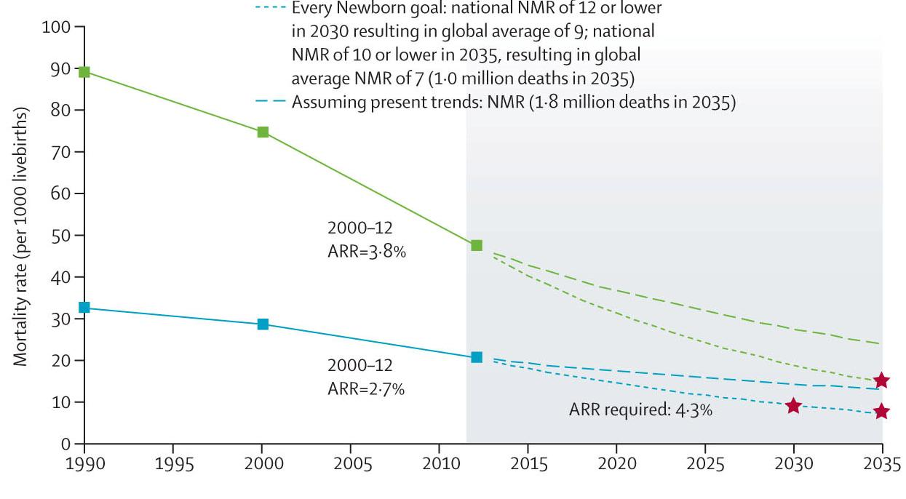
Ending preventable child deaths
A Promise Renewed target:
National U5MR of 20 or less
Every Newborn target:
National NMR of 10 or less
From 2.9 to 0.8 million neonatal deaths
About 29 countries will have to more than double their rates of progress Sub national equity goals should also be set
Source: Lancet Every Newborn series, paper 2

Slide 9
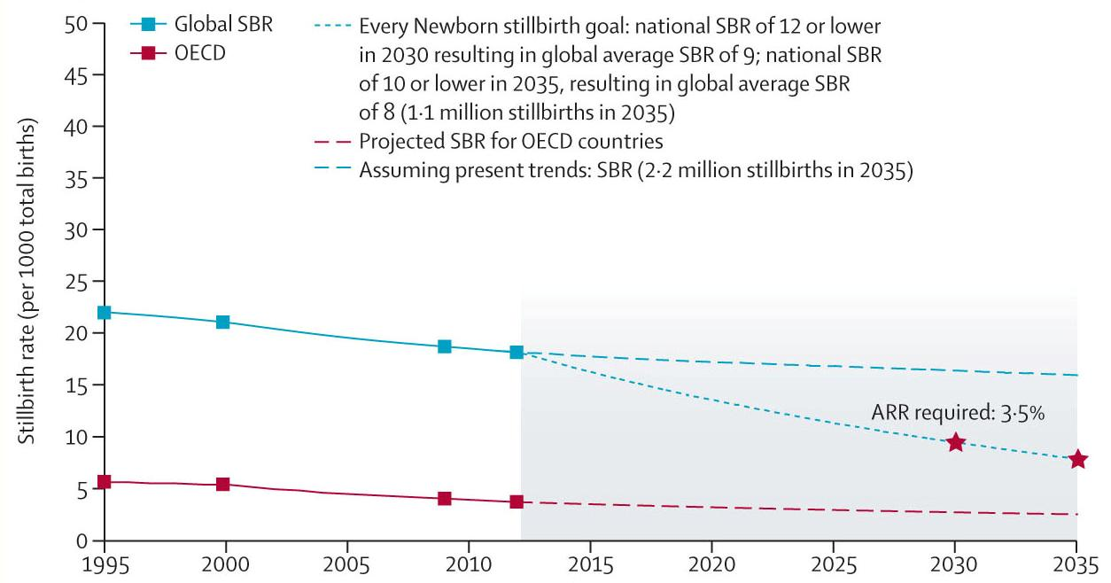
Also ending preventable stillbirths
Every Newborn target
National stillbirth rate of 10 or less
From 2.6 to 1.1 million stillbirths
Aligned with NMR target
Sub national equity goals should also be set
Source: Lancet Every Newborn series, paper 2

Slide 10
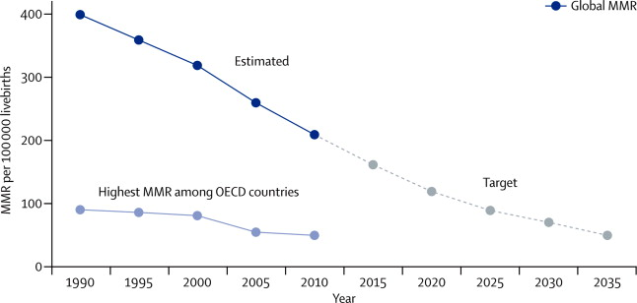
AND ending preventable maternal deaths Maternal mortality target being set based on Bangkok meeting, and included in Every Newborn Action Plan
Global average MMR of 70 per 100,000
With different targets for different countries
Lancet GH Sept 2013 : The Lancet Global Health 2013; 1:e176-e177 (DOI:10.1016/S2214-109X(13)70059-7)

Slide 11
Prioritize day of birth
Every Newborn Series key actions

Slide 12
Where?
Countries with highest neonatal mortality rates
Cen African Rep (40.9)
Mali (41.5)
DR Congo (43.5)
Lesotho (45.3)
Angola (45.4)
Guinea Bissau (45.7)
Somalia (45.7)
Sierra Leone (49.5)
The countries with highest neonatal mortality rates
2
1
Countries with highest numbers of neonatal deaths
1. India (779,000)
2. Nigeria (267,000)
3. Pakistan (202,400)
4. China (157,400)
5. DR Congo (118,100)
6. Ethiopia (87,800)
7. Bangladesh (75,900)
8. Indonesia (72,400)
9. Angola (41,200)
10. Kenya (40,000)
Source: Lancet Every Newborn series, paper 2

Slide 13
Where?
Countries in dark red are making slowest progress for newborn survival, 29 countries need to at least double progress to meet post 2015 targets
2
1
Source: Lancet Every Newborn series, paper 2
BUT in every region there are countries with rapid progress

Slide 14
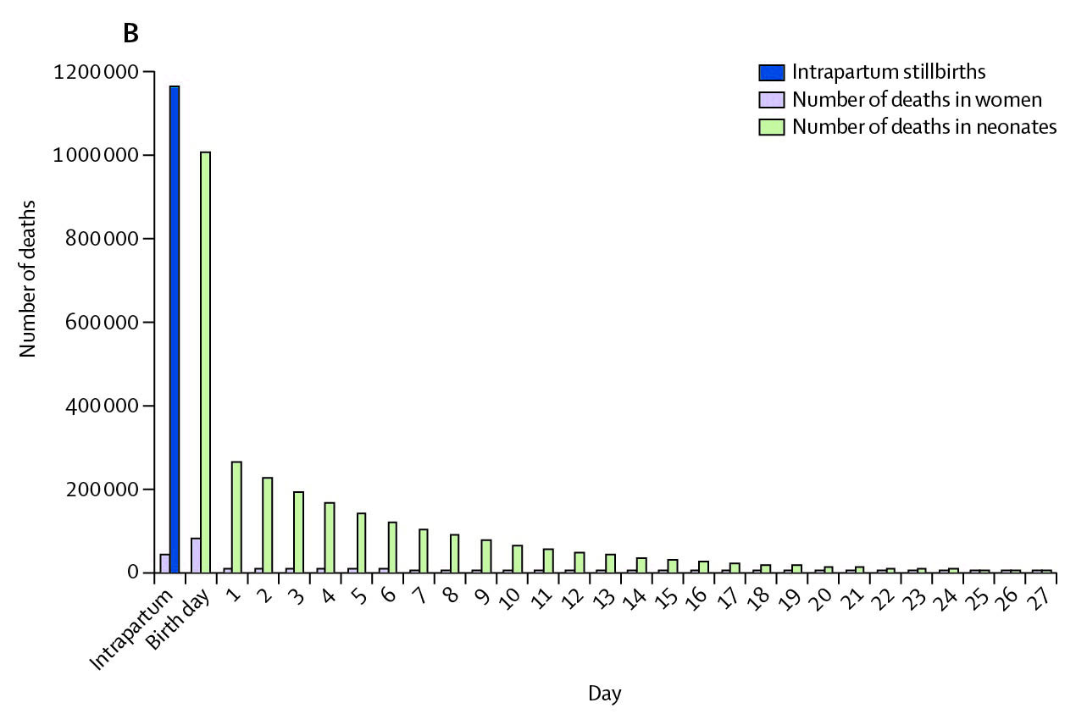
When? For women, stillbirths, newborns, the time of highest risk is the same
Birth day
1.2 million intrapartum stillbirths
>1 million neonatal deaths
~113,000 maternal deaths
75% neonatal deaths
Birth is the time of greatest risk of death and disability
Triple return on investment – quadruple if count development outcomes
Source: Lancet Every Newborn series Lawn et al

Slide 15
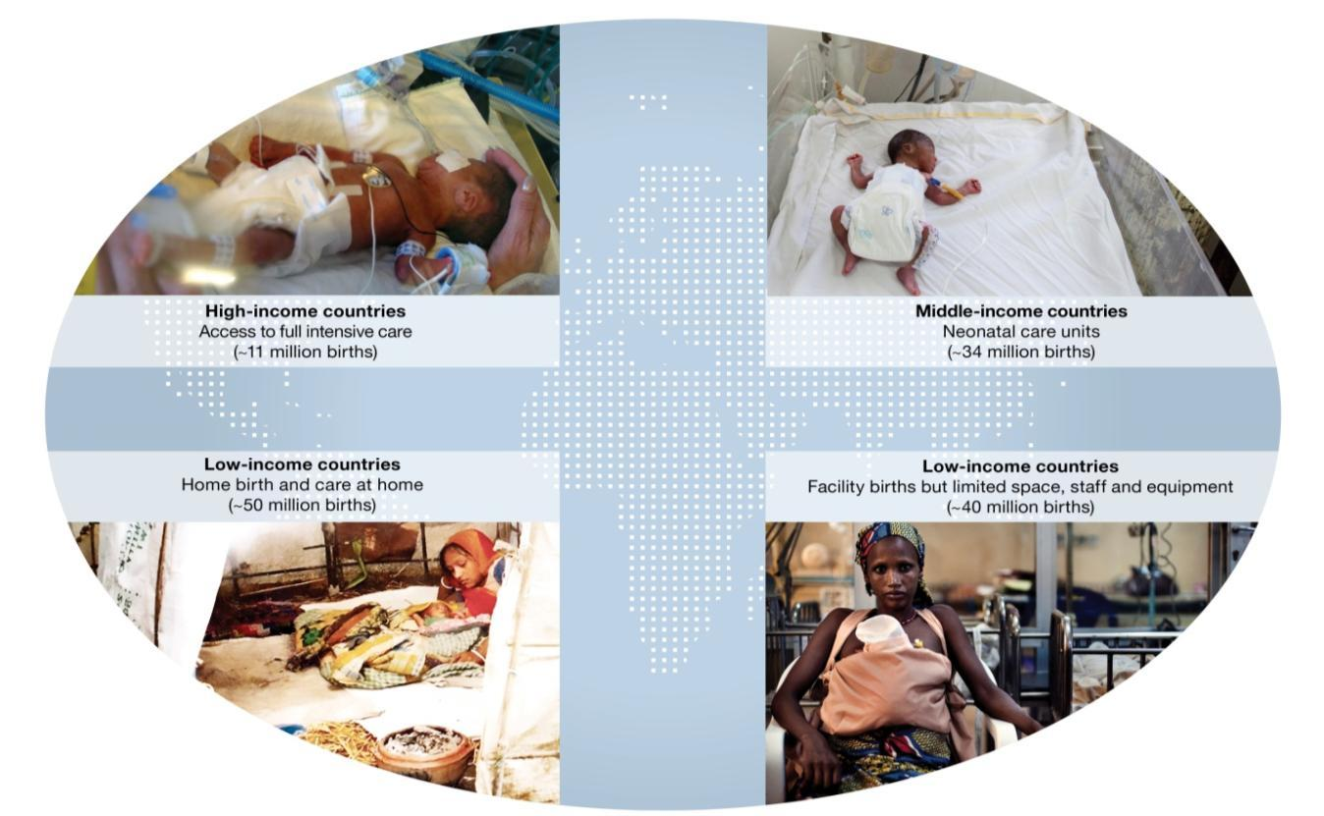
Beyond newborn survival
The world you are born into determines your survival and your risk of disability
In low income countries the major challenge is still survival
BUT in middle income countries higher disability
Must track and minimise disability as we scale up more complex neonatal care
Lawn et al http://www.nature.com/pr/journal/

Slide 16
What? Which neonatal conditions to focus on?
80% of newborns deaths are in small babies of which
2/3rds are preterm
2
3 main killers for newborns:
Preterm birth (“born too soon”)
Intrapartum complications (“birth asphyxia”)
Neonatal infections
3
1
Source: Lancet Every Newborn series, paper 2

Slide 17
The three main causes of newborn deaths all have effective and feasible interventions = 3 by 2
Preterm birth
Birth complications (and intrapartum stillbirths)
Prevention by skilled attendance and obstetrics*
Care including essential newborn care + resuscitation*
Neonatal infections
Prevention, essential newborn care especially breastfeeding, Chlorhexidine where appropriate*
Case management of neonatal sepsis with antibiotics *
Care including essential newborn care + Kangaroo mother care
Antenatal corticosteroids*, preterm labor management
1
2
3
71% of newborn deaths preventable
actionable now without intensive care
* Prioritised by the UN Commission on Life Saving Commodities for Women and Children
Notes:
We know how to reduce the main causes of neonatal death
We have the knowledge and tools to reduce at least two-thirds of these deaths. In 2012, PMNCH issued its consensus on essential interventions for RMNCH – those commodities and services proven to save lives of women and children. In 2013, we have heard from the UN Commission on Life-Saving Commodities for Women and Children, which highlight the importance of greater advocacy and action on corticosteroids, chlorohexidine, injectable antibiotics and resuscitation equipment to prevent newborn deaths. We need to work together, across all constituencies, to deliver these solutions at scale and drive greater public demand for essential newborn care.
For each of the main causes of death there are prevention and management evidence based solutions. This slides shows examples of some of these solutions.

Slide 18
Invest In care at birth and reap a triple return

Slide 19
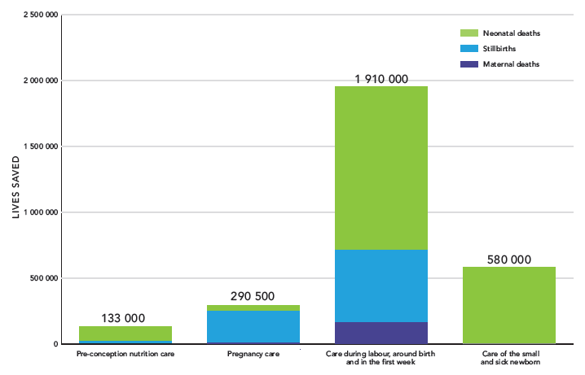
Lives that could be saved per year with universal coverage
Source: The Lancet Every Newborn series, paper 3

Slide 20
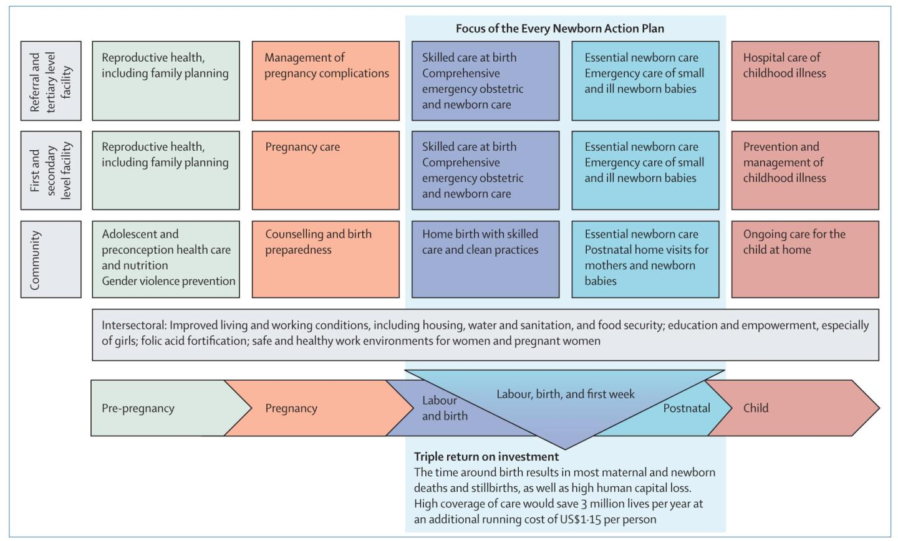
Packages for integrated care for women and children
CARE AT BIRTH, TRIPLE RETURN
Highest impact, Highly cost effective
Benefits women, stillbirths, newborns
3 MILLION LIVES SAVED PER YEAR
Running cost $1.15 per person
Source: Lancet Every Newborn series, paper 5

Slide 21
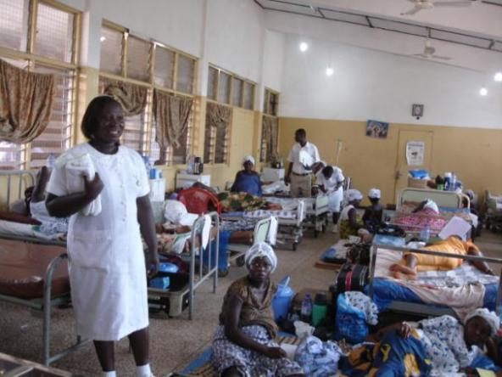
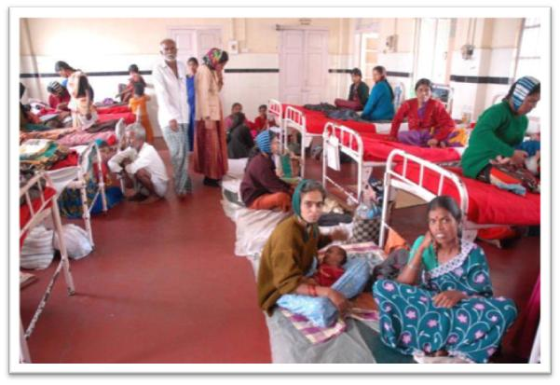
Care at birth, and care of small and sick newborns First opportunity is the QUALITY gap for facility births
Could save 2 million lives a year by closing this quality gap
Particular focus on health workers especially midwives
“Every Mother Every Newborn” quality initiative
Source: Lancet Every Newborn series, paper 3

Slide 22
Changes in ODA for MNCH
as tracked by Countdown to 2015
“Stillbirth” or “fetal” missing in donor funding databases
22%
Source: Lancet Every Newborn series, paper 1

Slide 23
TARGET SPECIFIC HEALTH SYSTEM BOTTLENECKS

Slide 24
Health systems bottleneck assessment
8 countries with >50% of newborn and maternal deaths were assessed: Afghanistan, Bangladesh, DRC, India, Kenya, Nigeria, Pakistan and Uganda
Common constraints are found in all these high burden countries
Workforce—Lack of competent healthcare workers, especially skilled midwives and nurses
Financing—limited funding specifically focused on newborns
Context-specific constraints, where despite similar health systems a particular intervention faces differing bottlenecks to scale up eg KMC with high perceived challenges in South Asia but not the African countries examined
Intervention specific findings – those with the most bottlenecks
Preventing/managing preterm births
Providing quality in patient care for small/sick babies
Management of severe infections
Quality and Equity Gaps …. for care around birth
Universal resolve to reach every woman and every newborn
Increase investment, medicines and health workers, with the skills, and autonomy to provide the right care for every woman and every newborn baby
Source: Lancet Every Newborn series, paper 2

Slide 25
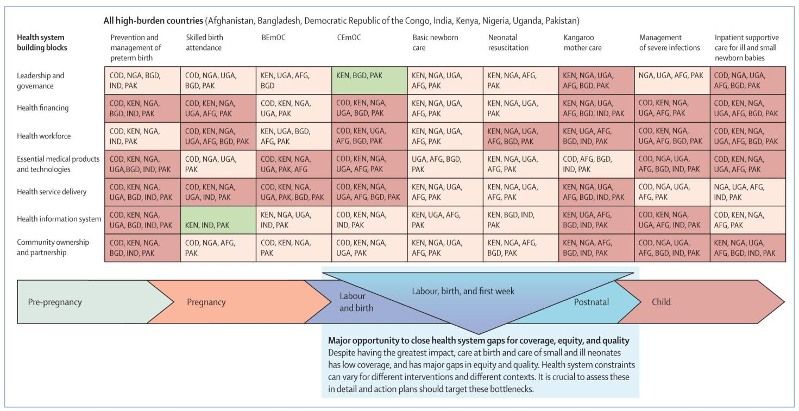
Health System bottleneck assessment for care around birth and care of small and sick newborns
MAJOR GAP IN COVERAGE, EQUITY AND QUALITY
Highest impact, most health system bottlenecks to address
Green 1-3 countries, orange 4-5 countries, red 6-8 countries
Source: Lancet Every Newborn series, paper 4

Slide 26
What works in fast progressing countries?
Lessons from countries that have reduced neonatal deaths
Malawi
Workforce planning increases numbers and specific skills
Peru
Financial protection measures including expansion of health insurance
Nepal
Dynamic leadership, innovation and community empowerment
Strategies to systematically scale-up care
High mortality countries → Improve supply, demand, equity and quality
Low mortality countries → Focus on quality and equity, and beyond survival
Source: Lancet Every Newborn series, paper 4
Notes:
Source: Paper 4

Slide 27
Unprecedented opportunity for progress is now

Slide 28
Vision for Every Newborn Action Plan
A world in which there are no preventable deaths of newborns or stillbirths, where every pregnancy is wanted, every birth celebrated, and women, babies and children thrive and reach their full potential

Slide 29
Every Newborn’s guiding principles
Country leadership
Good governance, community participation, partner alignment
Integration
Integrated service delivery, continuum of care, programme coordination
Equity
Universal coverage, closing the equity gap
Accountability
Transparency, oversight
Innovation
Interventions, delivery approaches, technologies
Human rights
Principles, standards

Slide 30
ENAP Strategic Objectives
Strategic objective 1
Strengthen and invest in care during labour, birth and the first day and week of life.
Strategic objective 2
Improve the quality of maternal and newborn care.
Strategic objective 3
Reach every woman and newborn to reduce inequities.
Strategic objective 4
Harness the power of parents, families and communities.
Strategic objective 5
Count every newborn through measurement, programme-tracking and accountability.

Slide 31
EVERY NEWBORN MILESTONE: Core indicators
 | Core ENAP Indicators | Additional Indicators
Impact | 1. Maternal Mortality Ratio
 | 2. Stillbirth Rate | Intrapartum Stillbirth Rate
 | 3. Neonatal Mortality Rate | Low birth weight rate
 |  | Preterm birth rate
 |  | Small for gestational age
 |  | Neonatal morbidity rates , eg infection
 |  | Rates of disability after neonatal conditions
Coverage: Care for all mothers and newborns | 4. Skilled attendant at birth | Early initiation of exclusive breastfeeding
 | 5. Early postnatal care for mothers and babies
 | 6. Exclusive breast feeding to 6 months
Coverage: Complications and extra care | 7. Antenatal corticosteroid use | Caesarean section rate
 | 8. Newborn resuscitation
 | 9. Kangaroo mother care, feeding support
 | 10. Treatment of neonatal sepsis
Counting | Birth registration | Death registration including cause of death
ENAP service delivery packages | Every Mother Every Newborn Quality Initiative
 | Care of small and sick newborn
Shaded = not currently routinely tracked.
Bold = indicator requiring additional evaluation for consistent measurement
Teal = input package requiring norms and standards to be defined
All indicators to be tracked so that they can be broken down to assess equity, e.g. urban/rural, regional, wealth quintile
We need to advance definitions and measurement for 10 core Every Newborn indicators, so countries and partners can track programmatic action
Source: Lancet Every Newborn series, paper 5
Notes:
Step 1: Developed matrix of the relevant indicators
According to ENAP Impact FW from impact (mortality) down to input level including financial such as ODA.
Step 2: Graded each indicator as follows:
Direct relevance to ENAP five obj and focus (from A to C)
Current availability of the data (from 1 to 3)
Step 3: Ranked indicators
By A to C, with A being closest match to ENAP focus.
By 1 to 3 where 1 is most currently available
It was agreed to prioritise indicators based on match/importance (category A) and then develop an urgent programme of work to improve the input data for those that are currently not available or only for a few countries.
eg HIV ART coverage data was lacking at the start of 3x5 but was quickly scaled up.
eg Malaria ITN data was also lacking but was addressed as a matter of urgency

Slide 32
Every Newborn Call for action
Goals in post-2015 development framework
Explicit national goals for neonatal mortality and stillbirths.
Milestones for action
Every Mother Every Newborn Quality Initiative.
Measurement of core Every Newborn indicators, operationalising perinatal audit.
Accountability framework in post-2015 architecture.
Implementation at national level
Update existing national health strategies to include Every Newborn mortality goals, coverage targets, and milestones, and 5 ENAP objectives
Investment
Increased investments from governments, donors and existing global funds..
Implementation research and upstream research investments
Intentional development of capacity, leadership, and champions.
Source: Lancet Every Newborn series, paper 5

Slide 33
We have the potential to transform survival and health for EVERY newborn EVERY mother including for the world’s poorest families –
Will we act on the call?
The time is now!
Every Newborn Action Plan
Get involved!
www.everynewborn.org
www.Healthynewborn.org

