Slide 1
Kangaroo Mother Care
The evidence for facility-based KMC and the rationale for application in community settings
Joseph de Graft-Johnson
ACCESS Program
Save the Children

Slide 2
Presentation Outline
contribution of preterm/low birth weight to newborn deaths
Evidence for using kangaroo mother care (KMC) to manage preterm/LBW babies at health facilities
Rationale for community KMC

Slide 3
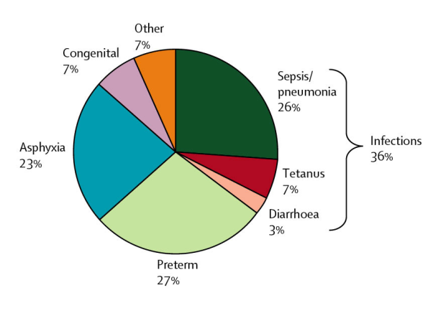
Causes of Newborn Deaths
LBW
60-80% Newborn Deaths occur in Low Birth Weight babies
Source: Neonatal Lancet team, March 2005.

Slide 4
The priority from a public health point of view is the group of larger / more mature LBW infants
Weight and gestational age distribution of LBW babies
Bang 2005
Courtesy Lily Kak & Indira Narayanan

Slide 5
Why do preterm/LBW babies die?
Inability to control body temperature -- hypothermia – increase risk to infections
Feeding difficulties -- hypoglycemia, and inappropriate/inadequate feeding – increase risk to infections
Other causes – respiratory distress syndrome, apnea, hyperbilirubinemia, & congenital malformation

Slide 6
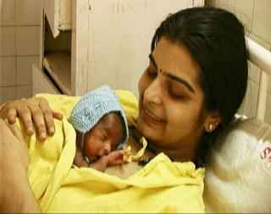
What is Kangaroo Mother Care?
“early, prolonged and continuous (as allowed by circumstances) skin-to-skin contact between a mother (or a substitute of the mother) and her low birthweight infant, both in hospital and after early (depending on circumstances) discharge, until at least the 40th week of post-natal gestational age, with ideally exclusive breastfeeding and proper follow-up”
Acta Paediatrica 1998;87:440-5

Slide 7
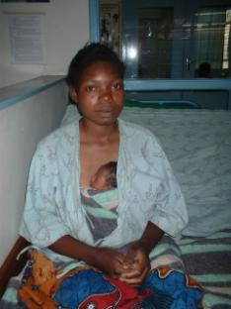
What is the evidence that KMC works?
Facility-based
Over 200 publications KMC
14 randomized control trials
Studies evaluated the effect of KMC on:
Mortality
Temperature
Breast-feeding
Weight gain
Infections

Slide 8
Effect on mortality

Slide 9
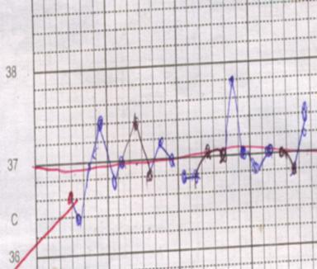
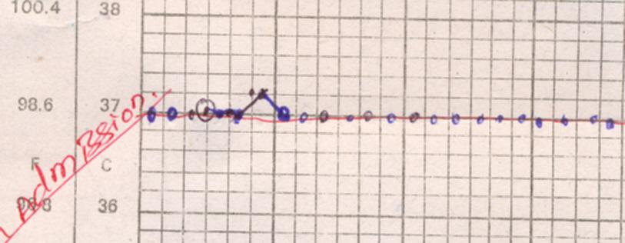
Effect on temperature
“Swings in temperature” “Constant temperature in KMC”

Slide 10
Effect on hypothermic LBW newborns
Christensson K et al. Lancet 1998;352:1115

Slide 11
Effect on breastfeeding
Better Breastfeeding rates with KMC!!!

Slide 12
Weight gain
2 RCT’s
KMC Control
Ramanathan, 2001 15.9 10.6* (g/day)
Cattaneo, 1997 21.3 17.7* (g/day)
Weight gain faster in KMC group
Earlier hospital discharge by 3-7 days
Weight similar at 1 year of age

Slide 13
Infections (severe)
KMC(%) Control (%)
Sloan, 1994
Serious illness 5 18
Lower Resp Inf 5 13
Charpak, 2001
Nosocomial 3.4 6.8
Lower rate of serious illness with KMC

Slide 14
The Cochrane Library, Issue 4, 2000.
Three RCTs – N= 1362 (Sloan 1994; Charpak 1997; and Cattaneo 1998)
Short comings: unblind collection of outcomes measures, handling of dropouts, completeness of follow-up
KMC associated with reduced risk of:
nosocomial infection at 41 weeks’ GA (RR 0.49; 0.25-0.93)
severe illness at 41 weeks’ GA (RR 0.30; 0.14-0.67)
lower respiratory tract disease at 6 months (RR 0.37; 0.15-0.89)
not exclusive breastfeeding at discharge (RR 0.41; 0.25-0.68)
maternal dissatisfaction (RR 0.41; 0.22-0.75)
KMC infants gained more weight per day by discharge (3.6 g/day; 0.8-6.4)
No evidence of a difference in infant mortality
Conde-Agudelo A et al, 2000

Slide 15
Can KMC be initiated before newborn is stabilized?
Bogale and Assaye 2001 (J. Trop. Pediatrics): KMC leads to faster stabilization compared to conventional care – 22.4% vs 38% deaths [N=123]
Bergman, et al (Acta pediatric 2004): LBW newborns assigned to skin-to-skin or incubators prewarmed at 36.5 C° for 6 hrs, after five minutes of routine care [40]:
All 18 SSC babies were stable in the 6th hr compared to 6 out of 13 of incubator babies
8 out of 13 incubator babies experienced hypothermia; none in SSC group
Stabilisation (Cardio-respiratory) score higher in KMC group
mean temp higher in KMC group in the first hour

Slide 16
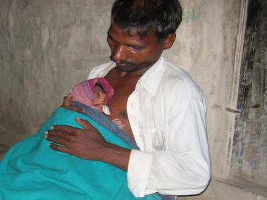
Why community KMC?
Most births occur at home (Approximately 60%)
Cultural practices prevent newborns being taken outside the home
Distance from facility also delays early postnatal care (PNC) for preterm/LBW babies
Prevention of hypothermia: immediate and adequate warmth needed
Prevention of hypoglycemia: immediate breastfeeding – normal or expressed required

Slide 17
What are some operational issues to consider?
Is KMC feasible and safe to initiate at home?
How to ensure appropriate and adequate breastfeeding?
How to monitor adequacy of weight gain?
Who coaches the mother and other family members?
What is the timing and frequency of the coaching?
What and who provides supportive supervision?
Adapted from Healthy Newborn Partnership meeting presentation by Dr. Cattaneo, 2003

Slide 18
Conclusion
Over two-thirds of preterm babies are late preterm (35-36 wks); Over two-thirds of LBW babies are at least 2000g or heavier
Clear evidence that KMC improves key newborn parameters: maintenance of warmth, breastfeeding and reduce infections
Facility-based KMC reaches a small proportion of preterm/LBW
Most preterm/LBW are delivered at home and care must be initiated at this level to save their lives

