Slide 1
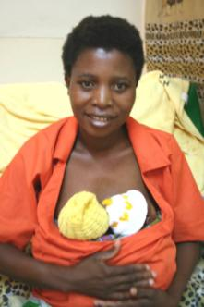
Effectiveness and Scale up of Kangaroo Mother Care
Anne Marie Bergh
Medical Research Council of South Africa / University of Pretoria
KMC materials adaptation workshop, February 2008

Slide 2
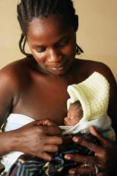
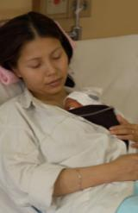
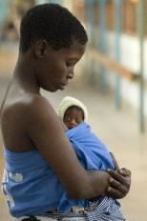
Outline
KMC, what and why?
Why and what?
Benefits to baby, mother, hospital
KMC in Malawi
Why and the start?
Where are we now?
Where to next?
Notes:
The Bellagio Child Survival Series (The Lancet 2003) identified newborn survival as a priority, lacking information and action
99% of newborn deaths are in developing countries - yet most information and investment is on high-tech solutions for the 1% of deaths in rich countries
The sheer numbers – every year 4 million babies die in the first 4 weeks of life – 10,000 a day and 40% of under 5 deaths
Despite large numbers of death, health of newborn babies was virtually absent from policies, programs, and research in the developing world
The new series presents new information and analysis regarding critical factors related to neonatal deaths, where and why newborns die and assessments of the effectiveness and costs of interventions for newborn care.

Slide 3
WHY? 1.2 million African newborns deaths
60 to 90% of neonatal deaths are in LBW babies, mostly preterm
Infections
39%
Improving survival for preterm babies is a key to rapid progress in saving newborns
Source: Opportunities for Africa’s Newborns, 2006. Based on vital registration for one country and updated modeling using the CHERG neonatal methods for 45 African countries using 2004 birth cohort, deaths and predictor variables.

Slide 4
Kangaroo Mother Care – what is it?
“early, prolonged and continuous (as allowed by circumstances) skin-to-skin contact between a mother (or a substitute of the mother) and her low birthweight infant, both in hospital and after early (depending on circumstances) discharge, until at least the 40th week of post-natal gestational age, with ideally exclusive breastfeeding and proper follow-up”
Acta Paediatrica 1998;87:440-5

Slide 5
Kangaroo Mother care: what does it involve?
KMC involves 3 key principles to care for babies, especially preterm babies:
Warmth, by positioning the baby skin-to-skin with the mother
Increased breastfeeding
Empowering the mother to care for her small baby and allowing early discharge home

Slide 6
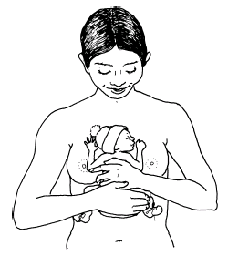
KMC Position
Place the baby between the mother’s breasts in an upright position
Turn the head to the side, in a slightly extended position
This is to keep the airway open
It also allows eye-to-eye contact between mother and baby
Avoid forward flexion & hyperextension of the neck
Infant should be in a flexed position - legs & arms
Secure baby with a binder / wrap
The top of the binder should be at the baby’s ear
WHO KMC practical guide

Slide 7
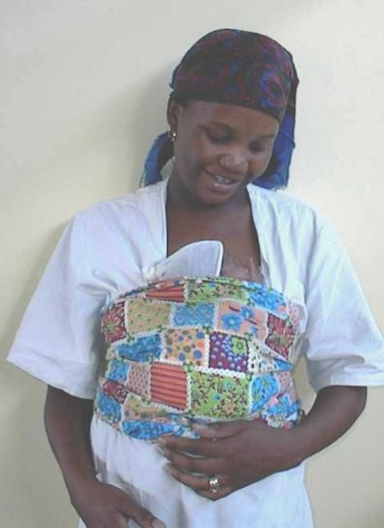
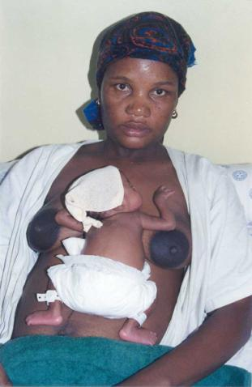
Kangaroo Position
Skin-to-skin on mother’s chest

Slide 8
Securing Infant in KMC Position
Tie the binder firmly enough so that the baby will not slide out
Make sure that the tight part of the cloth is across the baby’s chest
The baby’s abdomen should not be constricted
Baby should have enough room for abdominal breathing
Examples of different binders :
WHO KMC practical guide

Slide 9
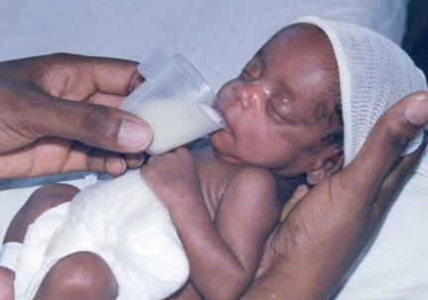
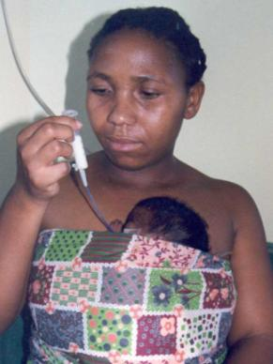
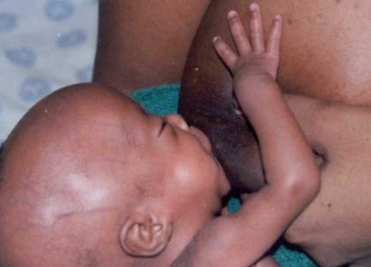
Kangaroo Nutrition
Exclusive breastfeeding
Initially tube or cup feeding before breastfeeding is established

Slide 10
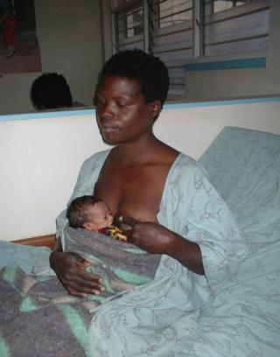
KMC: Evidence for benefit (Cochrane review)
Baby:
Increased weight gain
Higher % excusive breastfeeding
Less infections
Tendency to significant reduction in mortality
Reduced time in hospital
Increased bonding and maternal satisfaction
Cochrane review, 2004

Slide 11
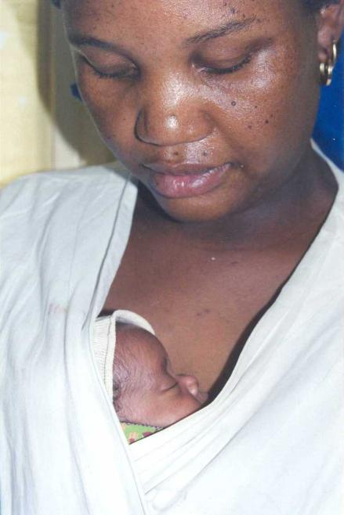
Benefits of KMC
To the baby
To the mother
To the hospital

Slide 12
KMC: Benefits to the Baby
Protection against infections
Decrease in infections especially poorly equipped units Sloan et al 1994, Kambarami et al 1998, Charpak N et al 1994, Cattaneo A et al 1998
Improved cardiac and respiratory stability
Fewer episodes of desaturation & apnoea Ludington, Bergman
KMC can successfully reduce/treat mild respiratory distress Ludington,Hoe & Swinth 1996
Higher initiation & duration of breastfeeding
⬇ energy expenditure & satisfactory weight gain
Improved gastrointestinal function, reduced risk of Necrotising enterocolitis

Slide 13
Benefits to the Mother
The mother’s confidence in caring for her infant is boosted
Improved bonding between mother and infant
Mothers are empowered to play an active role in their infants care
Breast feeding is promoted
Affonso D, et al 1989, PEP unit 43 Principles of KMC

Slide 14
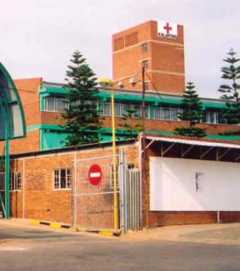
Benefits to the Hospital
Significant cost-savings as well as better outcomes
Less incubators required
Less nursing staff necessary
Shorter hospital stay
Improved morale & quality of care
Better survival
PEP unit 43 Principles of KMC

Slide 15
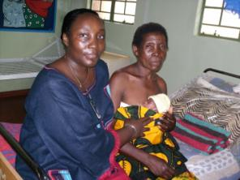
KMC in Malawi - why?
In Malawi, prior to the late 1980s LBW babies were nursed away from mothers in locally made incubators, a wooden box with a light bulb below the mattress for heat.
Babies stayed in the nursery 2 to 3 months if they survived, and mortality rates for preterm babies were high
Inadequate staff to care for and monitor babies
Congestion in the nurseries

Slide 16
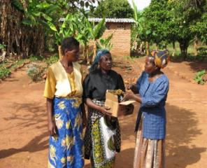
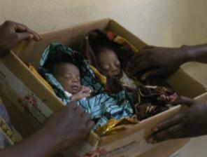
Moving to scale in Tanzania– the need for wider partnership and government leadership plus community involvement
Partnership needed to implement KMC services widely including:
Government of Tanzania (MOH-SW)
WHO
Save the Children, through Saving Newborn Lives
UNICEF
Community involvement:
Community health day
Community drama
Family involvement
CORPS

Slide 17
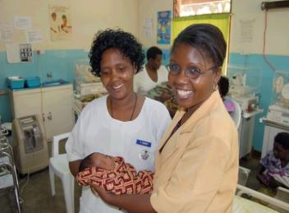
Monitoring KMC Implementation
KMC M&E system set up – register and monitoring sheet in each site
Drop out study conducted related to follow-up of babies discharged from KMC unit (found 1/3 babies lost to follow-up, died)
Costing assessment undertaken

Slide 18
Malawi KMC retrospective assessment – major findings
POLICY - National policy on KMC in writing and clearly articulated with good high level policy support
TRAINING - Good but intensive learning package in place
Preservice training has been successful strategy to increase scale
Inservice training currently requires 5 days off site training at one center so hard to scale up, and to be reduced and integrated
QUALITY - The quality and sustainability of implementation at 5 of the 6 sites was good, and other sites had tried to start. Despite lack of human resources, staff were dedicated. There were still opportunities to improve quality and simplify to help moving to scale.

Slide 19
Malawi KMC retrospective assessment – Opportunities to improve and save lives now
Use of intermittent KMC for babies who are still in a neonatal unit, not waiting until the baby or the space is ready for continuous KMC
Strengthening current feeding practices for all babies in KMC – job aids, supervision, using patient attendants to support mothers feeding
Use of KMC (just as skin to skin position) to transport babies between home and facilities or between facilities

Slide 20
Malawi KMC retrospective assessment – inservice training and supervision
Who gets trained and where
Given human resource crisis and frequent staff rotation more staff need to be trained and more at lower levels of implementation
Suggest shorter training off site for selected staff who then do on site training for the rest
Facilitation on site by a national coordinator led by MoH and transiting to local supervision

Slide 21
Malawi KMC retrospective assessment – inservice training and supervision
2. Content and approach to training
Modular units so can use in various training courses
Integrated MNH training
Stand alone 2 days KMC training
Half day as part of ENC course or other courses for other workers eg patient attendants or extension workers
More focus on implementation as well as clinical care – eg supervision, M&E, quality tracking etc.

Slide 22
KMC, quality improvement and moving to scale
Individual clinicians can make a difference but also requires partnership and Government ownership
Moving to scale, bringing care closer to families
Government plans to scale-up KMC to all district hospitals Investment by African Development Bank, ACCESS/Save the Children, and others with HCPs – good partnership
Harmonize different training manuals on MNH to develop a comprehensive essential obstetric and newborn care training manual that includes KMC, modular KMC training and more focus on implementation
Implementation research is important
Malawi (MoH, SNL and UNICEF) program to pilot community newborn care package that includes community KMC

Slide 23
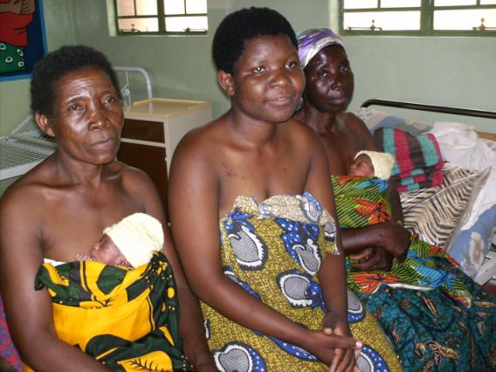
Thank you!

Slide 24
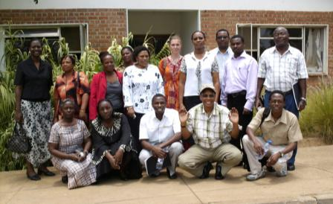
KMC in Tanzania
Led by the Ministry of Health
Learning visit to Malawi – November 2007
Materials adaptation – February 2008
Refurbishment and rollout at 6 Pilot Sites – by June 2008
Tumbi Special Hospital
Mlandizi Health Centre
Lindi Regional Hospital
Morogoro Regional Hospital
Kilwa District Hospital
Mbeya Referral Hospital

