Slide 1
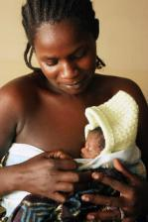
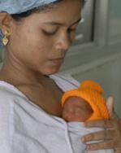
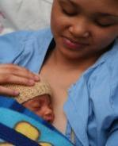

Kangaroo Mother Care: new evidence and experience in scaling up
ICNN/COINN
Durban, October 2010
Joy Lawn MB BS, MRCP (Paeds), MPH, PhD
Director Evidence and Policy
Kate Kerber MPH
Regional Advisor
Saving Newborn Lives/ Save the Children
Funded by the Bill & Melinda Gates Foundation

Slide 2

OUTLINE
Epidemiology, and the need
Evidence for KMC
Experiences in scaling up

Slide 3
The three main causes of neonatal death
2008 estimates for 193 countries
Infections 29%
1. 04 million every year
Source: Lawn JE et al Seminars in Perinatology, Dec 2010
Based on CHERG/WHO 2010, methods Black et al, Lancet 2010, Lawn JE IJE 2006

Slide 4
Causes of death in the neonatal period
for 193 countries (2000-2008)
Cause of death | 2000 | 2004 | 2008
Infection Sepsis Pneumonia | 1.04 (26%) | 0.94 (25%) | 0.89 (25%) 0.54 0.36
Diarrhoea | 0.11 (3%) | 0.07 (2%) | 0.07 (2%)
Tetanus | 0.26 (6%) | 0.10 (3%) | 0.07 (2%)
Preterm | 1.12 (28%) | 1.23 (33%) | 1.04 (29%)
“Asphyxia” | 0.91(23%) | 0.91 (24%) | 0.83 (23%)
Congenital | 0.30 (7%) | 0.31 (8%) | 0.29 (8%)
Other | 0.26 (6%) | 0.19 (5%) | 0.39 (11%)
Total | 4.0 million | 3.8 million | 3.6 million
Source: Lawn JE, Cousens SN, Adler A, Ozi S , Oestergen M, Mather C for the CHERG neonatal group. Based on CHERG/WHO estimates

Slide 5
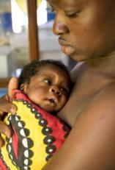
Kangaroo Mother Care
Definition
What?
Continuous, prolonged, early skin to skin contact between a baby and mother/other adult (up to 24 hour/day, several weeks)
Provides warmth, promotes breastfeeding, reduces infections and links with additional supportive care, if needed
Who?
Preterm/low birth weight babies (i.e. <2000g as marker of preterm birth <34wks)
Clinically stable (i.e. not requiring recurrent resuscitation)

Slide 6

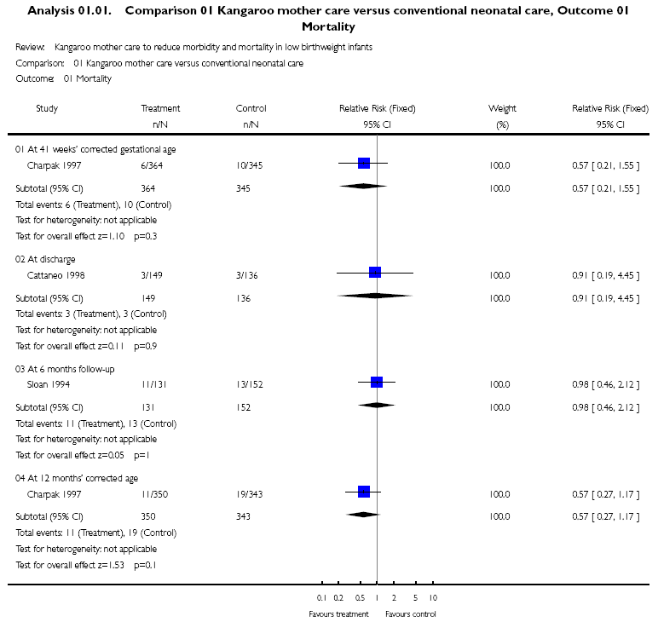
Cochrane review 2003, Conde-Agudelo A et al
Previous systematic reviews have not shown a significant mortality benefit of KMC
Non significant mortality result –
small numbers, mixed mortality outcomes,
some studies did not allow KMC in first week of life
New RCTs with neonatal mortality outcomes to consider

Slide 7

RCTs with mortality outcomes
Study | Ref (*in Cochrane) | Country | Case definition Numbers in trial | Outcome | Design/ limitations
1 | *Charpak et al. 1997 | Colombia | Neonates <2000g n = 746 | Mortality at 12 months -provided neonatal data | RCT - Outcome assessment not blinded
2 | Suman et al. 2008 | India | Neonates <2000g n = 206 | Mortality at 9 months - provided neonatal data | RCT - Outcome assessment not blinded
3 | Worku et al. 2005 | Ethiopia | Neonates <2000g = 123 | Neonatal mortality | RCT - Poor description of randomization and no post discharge follow up
4 | Sloan et al. 2008 | Bangladesh (community) | All Neonates n = 4165 (<2000g = 166; analysis restricted to <2000g) | Neonatal mortality | Cluster RCT - KMC variably implemented
 | *Sloan et al. 1994 | Ecuador | Neonates <2000g n = 300 | Mortality at 6 months | RCT - Outcome assessment not blinded
 | *Cattaneo et al. 1998 | Mexico Indonesia Ethiopia | Neonates 1000 - 1999g n = 285 | Pre-discharge mortality | RCT - Outcome assessment not blinded
Data from PI
EXCLUDED: Started KMC after one week of age
Source: Lawn et al (2010) ‘Kangaroo mother care’ to prevent neonatal deaths due to preterm birth complications. Int J Epidemiol: i1–i10.

Slide 8
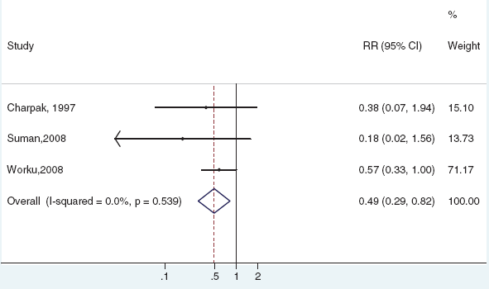
Meta-analysis of effect on neonatal mortality of facility-based KMC (3 RCTs, N 1075)
*
*
* neonatal specific outcome data from the principal investigator.
RR 0.49 (0.29, 0.82)
51% reduction in neonatal mortality
for neonates <2000 g with facility-based KMC
compared to conventional care
Source: Lawn et al (2010) ‘Kangaroo mother care’ to prevent neonatal deaths due to preterm birth complications. Int J Epidemiol: i1–i10.

Slide 9
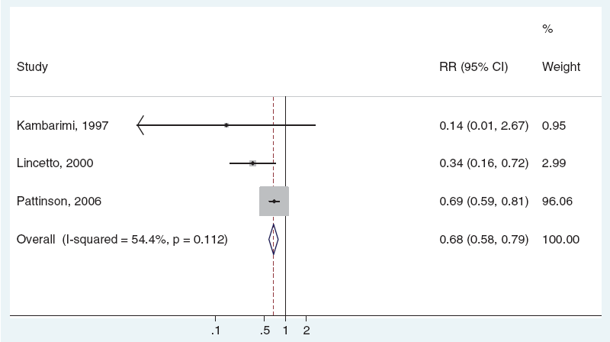
Meta-analysis on neonatal mortality of facility based KMC effect (3 observational studies, 17,961)
NOTE – All facility based
No convincing evidence yet for community-initiated KMC
RR 0.68 (0.58, 0.79)
34% reduction in neonatal mortality
for neonates <2000 g with facility-based KMC
compared to conventional care
Major effect on mortality possible at scale
Source: Lawn et al (2010) ‘Kangaroo mother care’ to prevent neonatal deaths due to preterm birth complications. Int J Epidemiol: i1–i10.

Slide 10
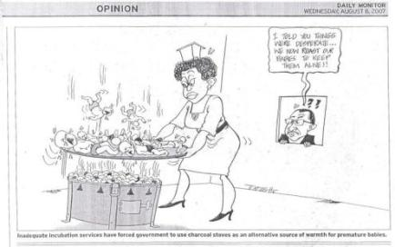
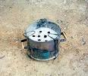
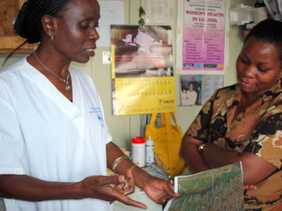
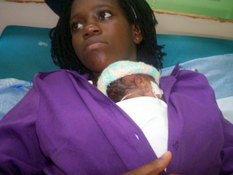


But, knowledge ≠ implementation

Slide 11

KMC in African countries:
a snapshot of scale up status
Scaling up
Ethiopia
1 teaching hospital (1997), rolling out to 7 regional, 1 zonal hospitals (2009)
Mainly referral hospitals only
Tanzania
5 pilot sites (SNL) 8 regional (ACCESS), expansion planned
Nigeria
3 N/States, 2regional, 1 teaching hosp. & plans to expand (PRRINN-MNCH)
Uganda
I teaching, 4 district hospital since (2004), expanding to 3 district (2010)
Cameroon
1 teaching hospital
Mali
1 teaching hospital (2008), 3 regional (2009/10, 2 district (2009)
Rwanda
Started in 2007, to be expanded (?)
Ghana
2 teaching hospitals (2008), 4 district hospitals in 2010, 4 regions in 2008 through MRC & UNICEF
Mozambique
5 regional (2009), 4 district hospitals (2010)
At wide scale
Malawi
32 district, 2 regional, 2 central,7 mission hosp, expanding - CKMC
(SNL/ACCESS/MCHIP)
Zimbabwe
1 national (Harare, 2000), 1 mission – plans to expand
South Africa
> 100 hospitals in all provinces many with supervision / quality tracking
Source – tracking by SNL/Save the Children.
KMC activities in DRC, Botswana, others? More information needed
Notes:
11

Slide 12

Some lessons learned
Planning phase
Demonstration sites or learning visits
National level process with MoH and key stakeholders
Advocacy - adaptation to local settings, translation of terms
eg “kumkumbatia mtoto kifuani”
Introductory phase
Site assessments, management buy in and commitment to sustain KMC
KMC master and transfer training
Supervision is key
Establishing sustainability, increasing coverage and quality
Integration of KMC with other training/education packages (in-service and pre-service) and other supervisions systems
Strengthen data collection
  Quantity of KMC versus quality

Slide 13
How to Choose Sites
Principle of expanding KMC services to peripheral levels of health system
Site Assessment is Key!
1. Need for KMC and expected case load
  Total # LBW born/admitted and total deliveries
  Total # deaths of LBW - past 6 months
  Current care for preterm/LBW
2. Readiness of space and staff
  Hosp. management buy in
  Staff available and willing – is there a champion?
  Space? What if no space is available? Renovation vs using existing space

Slide 14
Essential Equipment/Supplies
Cloth for wrapping baby (from mother or facility)
Beds, mattresses, linen
Graduated feeding cups
Wall thermometer
Body thermometer (low reading)
Baby weighing scales (digital)
Suction machine (foot or electrical)
Ambu bags and masks (suitable size)
NG tubes (size 4,5,6)
Wall room heaters
Mosquito nets (ITNs) where malaria is endemic
Others – fridge?

Slide 15
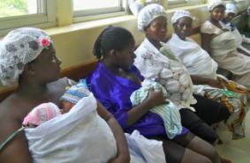
Challenges
Space and staff constraints
  Congestion in small KMC rooms
    Solution: Mothers practice KMC in other rooms (Mw)
  Insufficient nursing and clinical supervision of mothers
    Solution: patient attendants (Mw), limiting rotation (Gh)
Follow-up
  Lack of appropriate follow-up system
    Solution: systematise follow up, move appts closer to home iif feasible, consider community follow-up system (Mw)
Documentation
  Poor documentation especially re feeding and vital signs
    Solution: supervision for documentation (Mw, Ma)
No coverage data for KMC – possible through household surveys and urgent need to track program progress

Slide 16
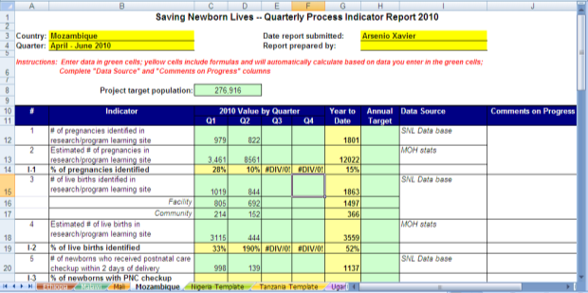
Measuring KMC
No standard indicators exist for facility-based KMC in routine HMIS or large-scale surveys
SNL has developed process indicators and tool to test (5 core and 5 supplemental)
Quarterly monitoring tool has been developed – could be adapted for facility, district, national tracking

Slide 17
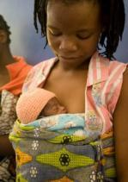
KMC indicators
Core (proposed):
% of eligible (<2kg, stable) babies on admission to facility who received KMC
% of facilities where KMC is operational
% of health providers trained in KMC
% of eligible babies on admission who received KMC and survived to discharge
% of babies who received KMC that were lost to follow-up prior to discontinuation of services
Saving Newborn Lives KMC working group draft indicators (2010)

Slide 18
KMC indicators
Supplemental (proposed):
% of health providers trained in KMC (of those caring for babies? TBC)
# of health facility staff oriented to KMC
Average length of stay for KMC (in days)
Average number of follow-up visits among KMC babies discharged from facility
% of eligible babies on admission who graduated KMC
Saving Newborn Lives KMC working group draft indicators (2010)

Slide 19
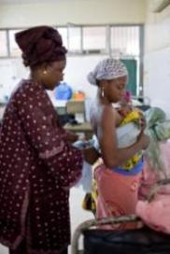

Scaling up KMC
– some research questions
Bringing services closer to home:
  Expanding KMC to district hospitals and health centres – feasibility, cost, effect on quality?
  Effectiveness and safety of community initiation of KMC
Innovation for challenging settings: e.g. task shifting, eg intermittent KMC – what is effect??
  Training models Shorter, integrated off-site training or on-site facilitation and support
Tracking: Testing indicators for process and coverage
Cost: to the health system, an cost savings, cost to family
Notes:
19

Slide 20
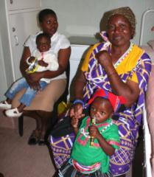

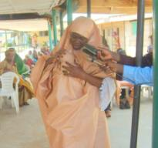
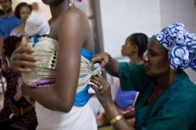
KMC – every baby counts!
Malemulele Hospital KMC graduates
– 700g and 800g
(Tanzania)
“I know my baby is going to survive”
Nsambya Hospital Guestbook, Uganda
Photo essay highlights KMC in Hopital Gabriel Toure, Mali
Northern Nigeria – KMC can still be modest!
Plan to reach every baby who needs KMC –
Use the power of individual stories

Slide 21
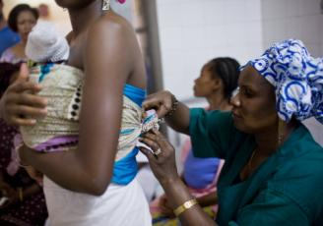
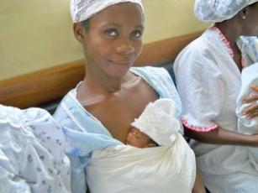
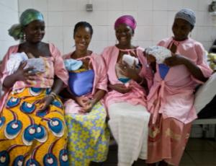
Thank you!

