Slide 1
Born Too Soon:
The Global Action Report on
Preterm Birth
Malawi Survive and Thrive briefing meeting
August 2012

Slide 2
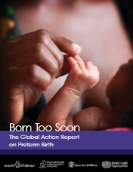
Born Too Soon - a global action report
4 lead organizations and almost 50 partner organizations including
United Nations
NGOs
Professional organizations
Universities
45 authors from 11 countries including scientists, epidemiologists and clinicians
Linked to Every Woman Every Child, with forward written by UN Secretary General Ban Ki-Moon
Information at www.who.int/pmnch/media/news/2012/preterm_birth_report/en/index.html

Slide 3
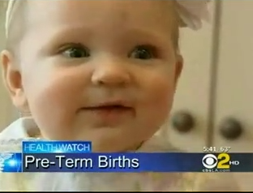
Born Too Soon - global media attention
20 TV broadcasts worldwide, including BBC, ABC, CBS, NBC, FOX, Channel 4 UK, Al Jazeera
Over 75 articles in US newspapers and magazines, including front page of New York Times, USA Today, Chicago Tribune
Over 100 articles in European newspapers and Science magazines, including The Guardian, Nature, BMJ, as well as journals in French, German, Dutch, Russian and many other languages
Africa and Asian regional coverage eg front page of Daily Times Malawi, Ghana Nation, All Kenya News, All Africa, Pakistan Times etc
Global launch on May 2, 2012 at the United Nations, New York
WHY ALL THIS ATTENTION NOW?

Slide 4
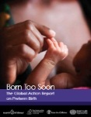
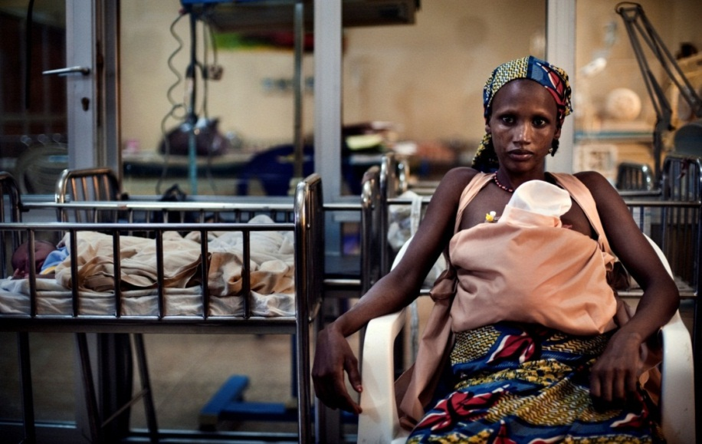
Global health perspective –
Preterm birth is now a leading cause of child death
Every year, 7.6 million children die before their 5th birthday, with increasing progress since 2000 related to Millennium Development Goals
Over 40% of these deaths now
occur in the first month of life, the neonatal period.
Preterm birth is the second leading cause of death for children under 5 years, after pneumonia
1.1 million babies die directly from complications of preterm birth
Source: CHERG/WHO estimates for 2010, Li Liu et al Lancet in press, 2012

Slide 5
Born Too Soon: 5 main findings
15 million babies are born too soon every year
Preterm birth rates are rising
Prevention of preterm birth must be accelerated
Premature babies can be saved now with feasible, cost-effective care
Everyone has a role to play
1
2
3
4
5

Slide 6
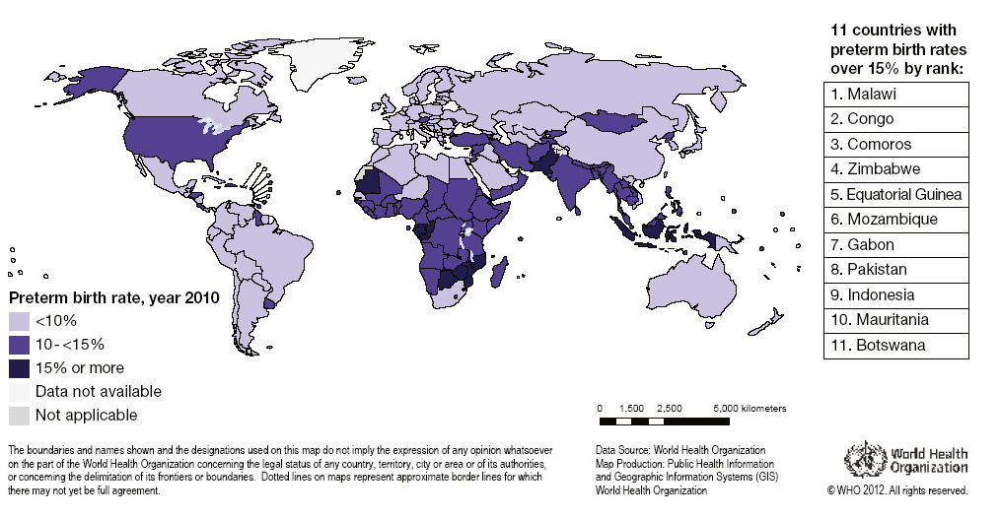
First ever national estimates of preterm birth for 192 countries – where are the highest rates?
11 countries with preterm birth rates over 15%
Malawi
Congo
Comoros
Zimbabwe
Equatorial Guinea
Mozambique
Gabon
Pakistan
Indonesia
Mauritania
Botswana
Of the 11 countries with the highest rates, 9 are in Africa
Note: rates by country are available on the accompanying wall chart. Not applicable=non WHO Members State
Source: Blencowe et al National, regional and worldwide estimates of preterm birth rates in the year 2010 with time trends since 1990 for selected countries: a systematic analysis and implications

Slide 7
Dual track to reduce the burden of preterm birth
Prevention of preterm birth
Premature baby care
Preconception care package especially family planning
Antenatal care package
Effective childbirth care
Policy support including smoking cessation and employment safeguards of pregnant women
Essential and extra newborn care, especially feeding support
Neonatal resuscitation
Kangaroo Mother Care
Management of premature babies with complications especially respiratory distress syndrome, infections and jaundice
Progressing towards comprehensive neonatal intensive care
Management of preterm labor
Tocolyics to slow down labor
Antenatal corticosteroids
Antibiotics for pPROM
Reduction of preterm birth
Mortality reduction among babies born preterm

Slide 8
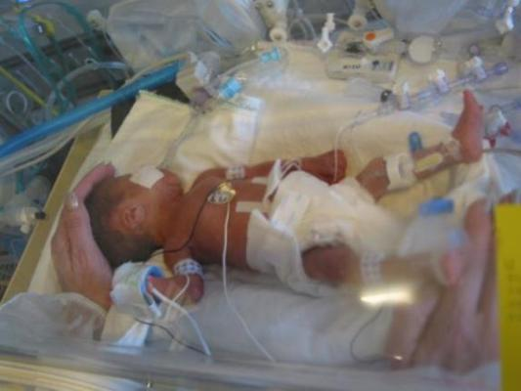
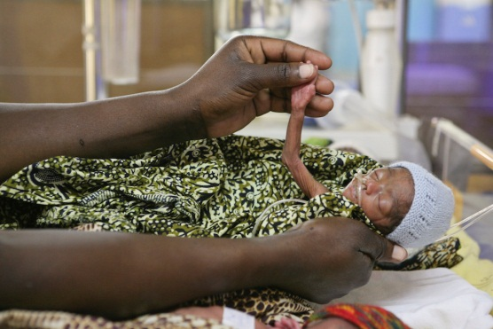
... And over 1 million of these preterm babies die
Survival gap
10 90
Over 90% of extremely preterm babies (<28 weeks) born in high-income countries survive;
yet less than 10% of these babies survive in low-income settings.
YET
Over 75% could be saved without intensive care

Slide 9
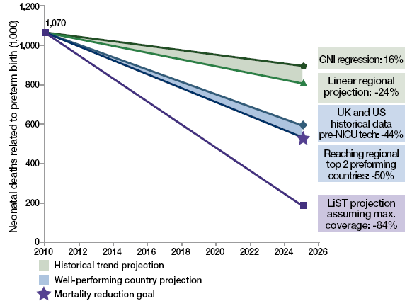
Everyone has a role to play... New mortality goal set
Goals for reduction of preterm birth mortality by 2025
Analyses to define goal
For countries with neonatal mortality rate level >5 per 1,000 live births, reduce the mortality due to preterm birth by 50% between 2010 and 2025
For countries with a current neonatal mortality rate <5 per 1,000 live births, to eliminate remaining preventable preterm deaths, focusing on equitable care for all and quality of care to minimize long-term impairment
After .. this report, a technical expert group will be convened to consider a goal for reduction of preterm birth rate by 2025, to announce on World Prematurity Day 2012.
Over 500,000 babies will be saved each year when we reach our target
Source: Analysis conducted by Mortality Reduction Goal Group and Boston Consulting Group using multiple data sources (Liu et al., 2012; EIU GDP projections 2010 to 2030; WorldPopulation Prospects, 2010; UN Department of Economic and Social Affairs; LiST analysis). Note: Analysis is for countries with NMR of more than 5 per 1,000 live births; other countries are excluded. Interventions in the LiST analysis included KMC, antenatal corticosteroids, antibiotics for pPRoM, skilled birth attendance, and others.

Slide 10
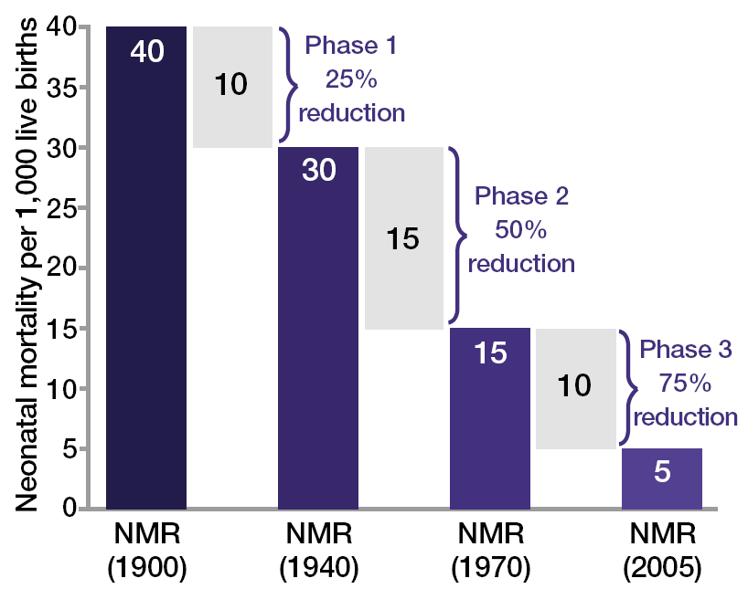
Premature babies can be saved before intensive care is available...
Public health approaches
Improved individual neonatal care eg feeding, warmth, hygiene, antibiotics, resuscitation
Neonatal intensive care introduction and scale up:
Over 60% reduction can be achieved before neonatal intensive care
and history shows the impact would be huge
Data sources for UK and US historical data: (CDC, 2012, Office for National Statistics, 2012, NIH, 1985, Smith et al., 1983, Jamison et al., 2006, Lissauer and Fanaroff, 2006, Baker, 2000, Philip, 2005, Wegman, 2001). With thanks to Boston Consulting Group

Slide 11
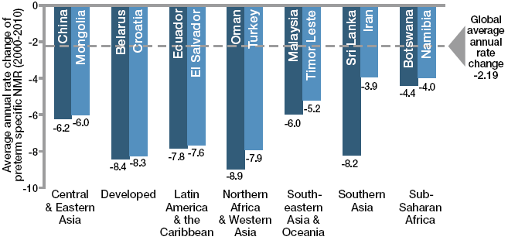
Some middle income countries have halved deaths due to preterm birth in a decade
Sri Lanka
Lower middle-income country reduced NMR from 13 to 10 and halved preterm specific mortality
Long term investment in primary care, free health care at government facilities
Reinvigorated community-based care, including referral for women in preterm labor
Recent carefully planned improvements at tertiary care centers for neonatal intensive care special training for specialists and more use of technology
Turkey
Upper middle-income country reduced NMR from 21 to 10
Implemented demand and supply strategies, including cash incentives and maternity waiting homes for expectant women
Invested in health system improvements, such as focusing on nursing staff skills, resuscitation, basic care of preterm babies
Source: Chap 6 , Born too soon, Analysis conducted using data from Liu et al., 2012. Credit: Boston Consulting Group with the Global Preterm Birth Mortality Reduction Analysis Group

Slide 12
Potential for lives saved through steroid injections for women in preterm labor
Respiratory complications due to lung immaturity (RDS) are the commonest cause of death in preterm babies.
Single course of antenatal steroids to women in preterm labour:
31% Mortality reduction (RR 0.69, 95% CI 0.58 to 0.81) for babies in settings where ventilation (+/-surfactant is standard of care (Cochrane review))
53% reduction in mortality in 4 studies in middle income countries (RR 0.47, 95% CI 0.35 to 0.64)
Dexamethasone is low cost (<$1) and available in many settings but low coverage in low and middle income settings
One of the 13 priority medicines for MNCH on UN Commodities Commission
Could save about 400,000 babies each year if reached 95% of women in preterm labor (LiST analysis)

Slide 13
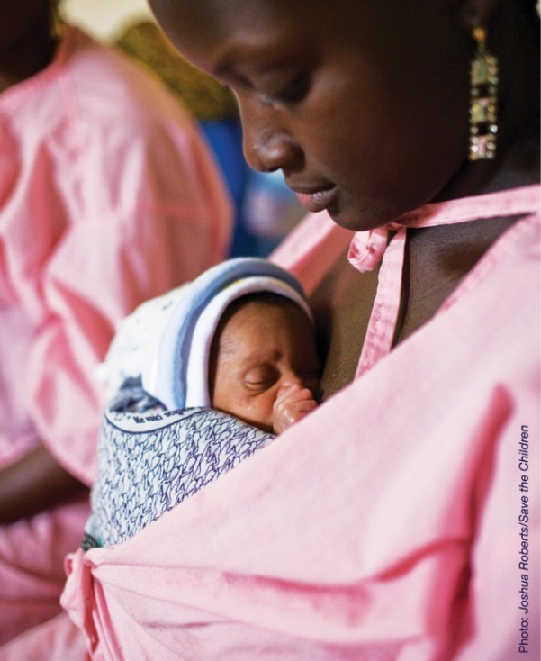
Potential for lives saved through kangaroo mother care
Continuous Kangaroo Mother Care is when baby is tied skin to skin with mother 24 hours a day for days/weeks providing
thermal care,
increased breastfeeding, better weight gain
reduced infections and links to additional supportive care, if needed, and earlier discharge
Mortality reduction 51% for babies < 2000 gm, in facilities, clinically stable and KMC started within one week compared to incubator care
Effective entry point for care of preterm babies
Could save about 450,000 babies each year
if reached 95% of preterm babies (LiST analysis)
Lawn et al ‘Kangaroo mother care’ to prevent neonatal deaths due to preterm birth complications. Int J Epid: 2010,
Conde Aguedelo Cochrane review 2011

Slide 14
Multi-agency team formed to accelerate scale up of care for preterm babies especially in high burden , low income countries
Continued awareness of the issue
Critical analysis of scale up process, enablers and constraints
Champion countries

Slide 15
Malawi is needed as a champion country
What is a champion country?
Attention from high level policy makers to the issue of preterm birth
Already implementing and willing to strengthen implementation of preterm birth interventions within existing care packages
Adopt a continuum of care and interdisciplinary approach utilizing a wide range of healthcare professionals and partners, including parents and grandparents
Act as a regional and global centre of excellence for some aspects of preterm prevention or care
Announce commitment and approach to reducing preterm associated mortality in conjunction with World Prematurity Day, Nov 2012
What are the benefits?
Recognition as a leader in caring for preterm babies – our most vulnerable citizens
Increased harmonisation of technical and financial support especially for high impact care
Spill over benefits into RMNCH care eg addressing pre-eclampsia
Accelerated reductions in morbidity and mortality due to preterm birth

Slide 16
Attention for preterm birth as a major issue in Malawi
Malawi has the highest preterm birth rates globally
Preterm birth is the leading cause of neonatal deaths in Malawi
Malawi
18.1
Congo
16.7
Comoros
16.7
Zimbabwe
16.6
Equatorial Guinea
16.5
Mozambique
16.4
Gabon
16.3
Pakistan
15.8
Indonesia
15.5
Mauritania
15.4
Botswana
15.1
0
5
10
15
20
Preterm birth rate

Slide 17
Malawi has already taken a stand on preterm birth, and wants to accelerate progress
World Health Assembly breakfast for Born Too Soon
More than 70 participants from 30 countries
Key speakers at the event included:
Professor Chen Zhu, Minister of Health of China
Dr. Charles Mwansambo, Principal Secretary of the Ministry of Health of Malawi
Dr. Joy Lawn, Director of Global Evidence and Policy at Saving Newborn Lives, Save the Children and a co-editor of the Born Too Soon report
Dr Charles Mwansambo, Principal Secretary for Health and long term champion of newborn care in Malawi

Slide 18
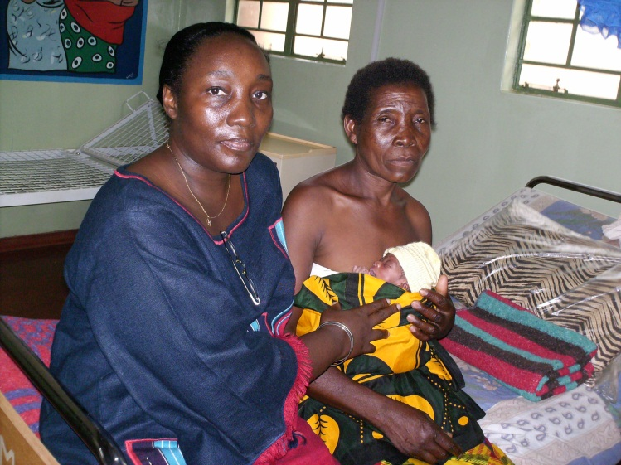
Malawi has already played a leadership role especially for Kangaroo Mother Care
Status of national scale up
Center of excellence for KMC
KMC unit established in Zomba Central Hospital in 1999
Malawi now has 121 KMC units throughout the country
Each of the 28 government-run district hospitals has a KMC unit
For example in 2007 teams of policymakers visited Malawi to understand KMC and plan scale up in their own countries including
Tanzania
Mali
Nigeria
Photo: Georgina Msemo from the Ministry of Health of Tanzania with mother and baby in Malawi

Slide 19
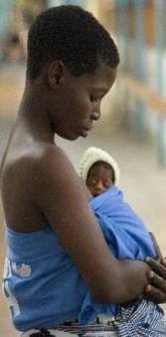
What could Malawi do?
Assessment, scale up of antenatal corticosteroids
Increased coverage and quality of KMC, and acting as center of excellence, support for other African countries
Innovative referral care of preterm babies (eg CPAP)
Prevention of preterm birth is a key issue for review and strategic progress eg management eg infections and hypertension in pregnancy
Discussion and ideas welcome
ZIKOMO!

Slide 20
We are the first generation with tools, funding and opportunities to transform maternal newborn and child survival and health for the world’s poorest families
Will we deliver for preterm babies and their mothers in Malawi?

